Slide 1
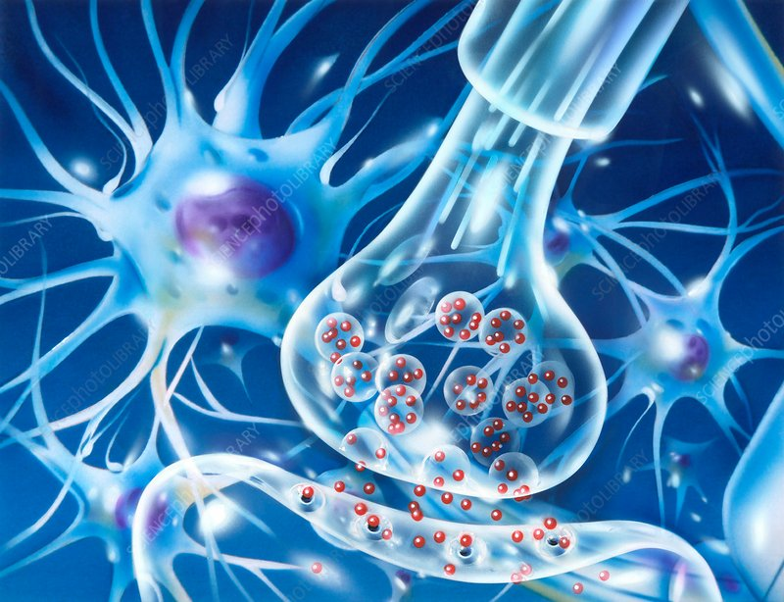
Synapse and neuromediators
Ondřej Novák

Slide 2
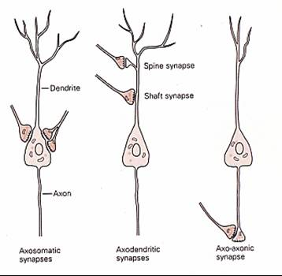
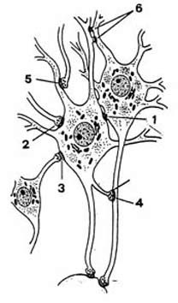
Inter-neuronal communication
Different target⬄ different impact
Notes:
Úkolem jednotlivých neuronů je přijmout informaci (aktivita neurontransmiteru na synapsích – změna potenciálu vlivem chemických synapsí), tu zpracovat a vyhodnotit s přihlédnutím k podmínkám, dlouhodobé i krátkodobé historii a vytvořit výstup typu 1vs0 (akční potenciál), který je odeslán na další neurony v lokální síti, popřípadě na neurony vzdálenějších jader, popřípadě jsou jeho synapse přímo spojeny efektorem (nervosvalová ploténka). Impakt daného neuronu vysílajícího signál na příjemce signálu je dán frekvencí akčních potenciálů vyslaných po axonu na synapsi.

Slide 3
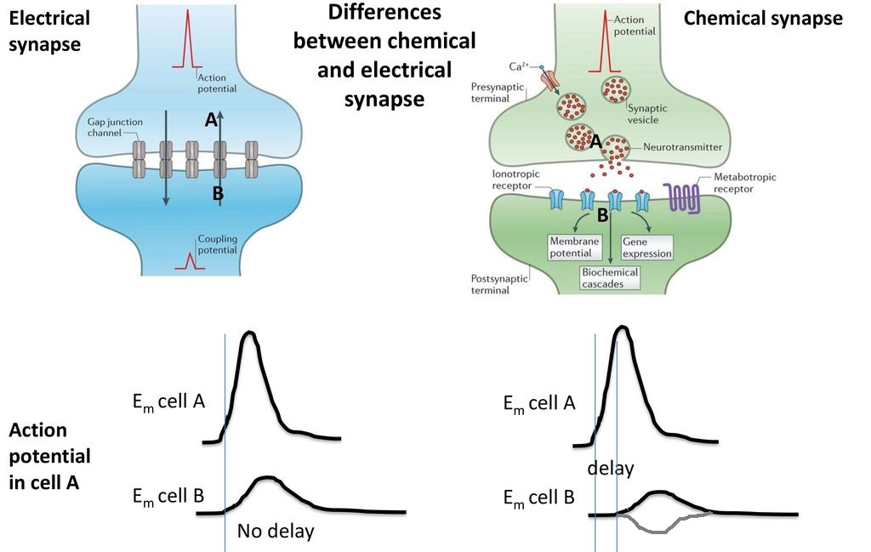
Synapse – two main types
Notes:
Úkolem jednotlivých neuronů je přijmout informaci (aktivita neurontransmiteru na synapsích – změna potenciálu vlivem chemických synapsí), tu zpracovat a vyhodnotit s přihlédnutím k podmínkám, dlouhodobé i krátkodobé historii a vytvořit výstup typu 1vs0 (akční potenciál), který je odeslán na další neurony v lokální síti, popřípadě na neurony vzdálenějších jader, popřípadě jsou jeho synapse přímo spojeny efektorem (nervosvalová ploténka). Impakt daného neuronu vysílajícího signál na příjemce signálu je dán frekvencí akčních potenciálů vyslaných po axonu na synapsy.

Slide 4
Electrical synapse
Permeable for molecules <1500Da
Ions, second messengers, small polypeptides
Connexin32 – Charcot-Marie-Tooth disease (demyelination)
Cofnnexin26 – Deteriorated cochlea function – up to 50% of congenital deafness

Slide 5
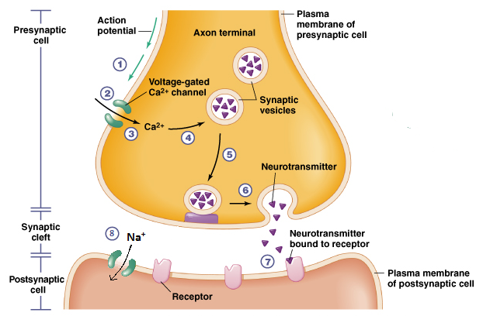
Chemical synapse
Astrocyte
Signal amplification
Other possible impact along with the electrical
Spatial context

Slide 6
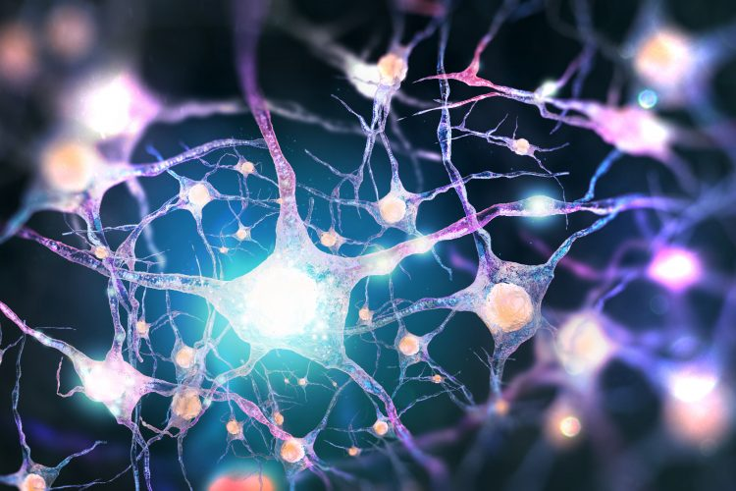
Short morphological intermezzo

Slide 7
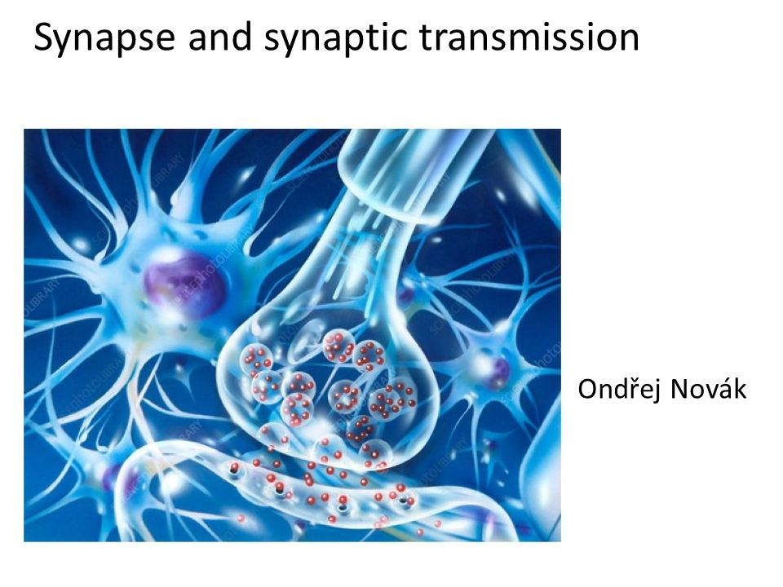
Short morphological intermezzo

Slide 8
Short morphological intermezzo
FAKE images of synapses !!!

Slide 9
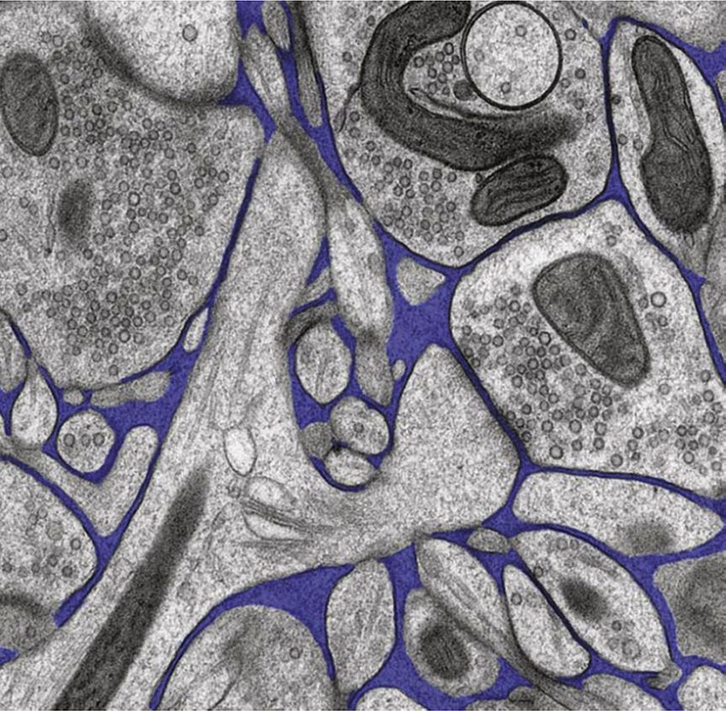
Short morphological intermezzo

Slide 10
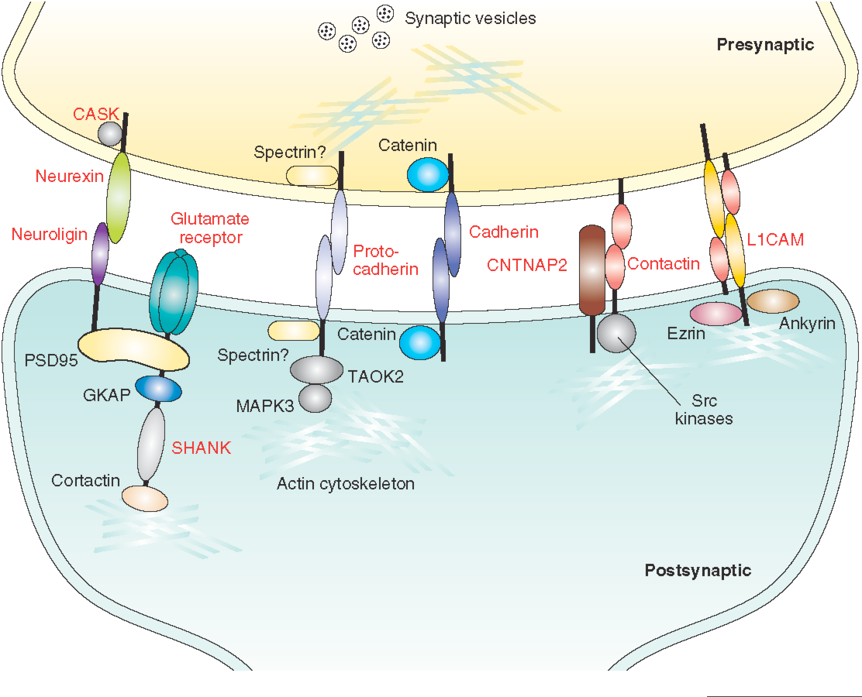
Short morphological intermezzo

Slide 11
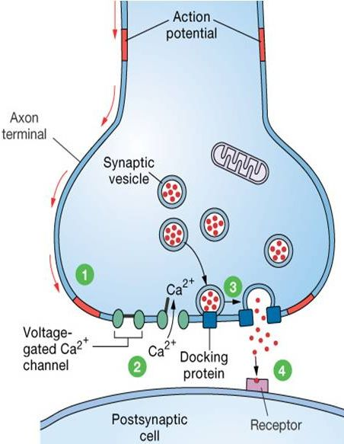
Chemical synapse – basic presynaptic mechanisms

Slide 12
Chemical synapse – basic presynaptic mechanisms

Slide 13
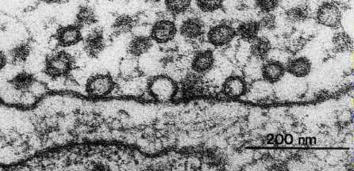
Chemical synapse – basic presynaptic mechanisms

Slide 14
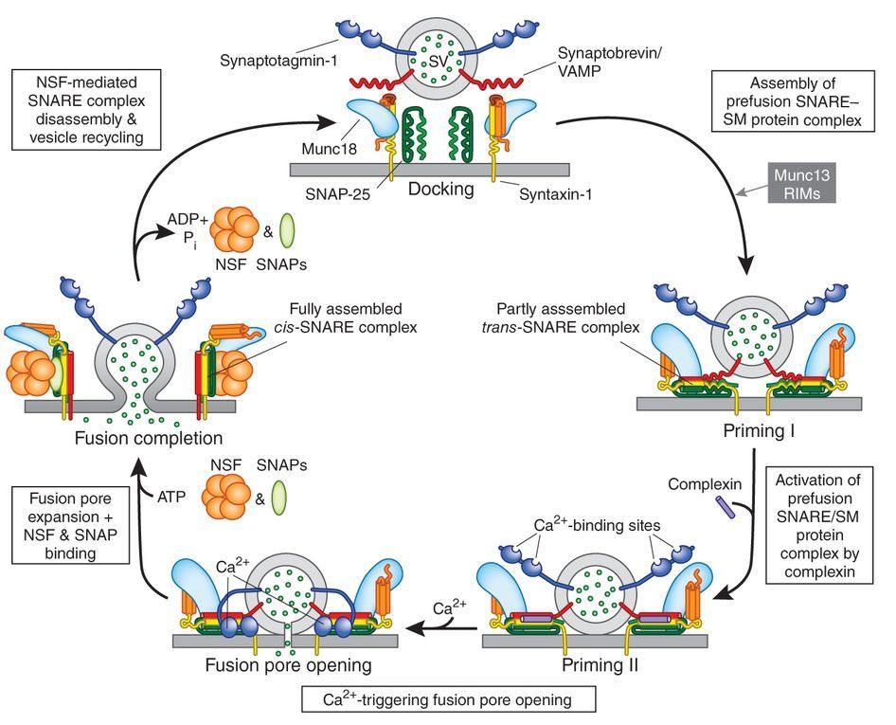
Chemical synapse – advanced presynaptic mechanisms

Slide 15
Chemical synapse – NT recycling and vesicle filling

Slide 16
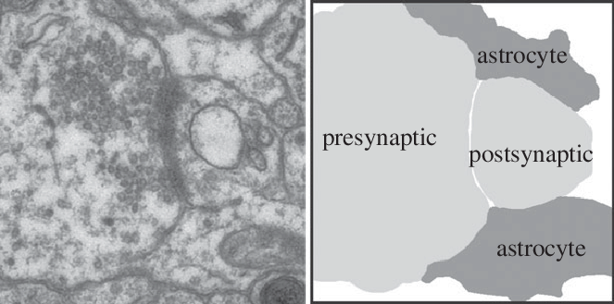
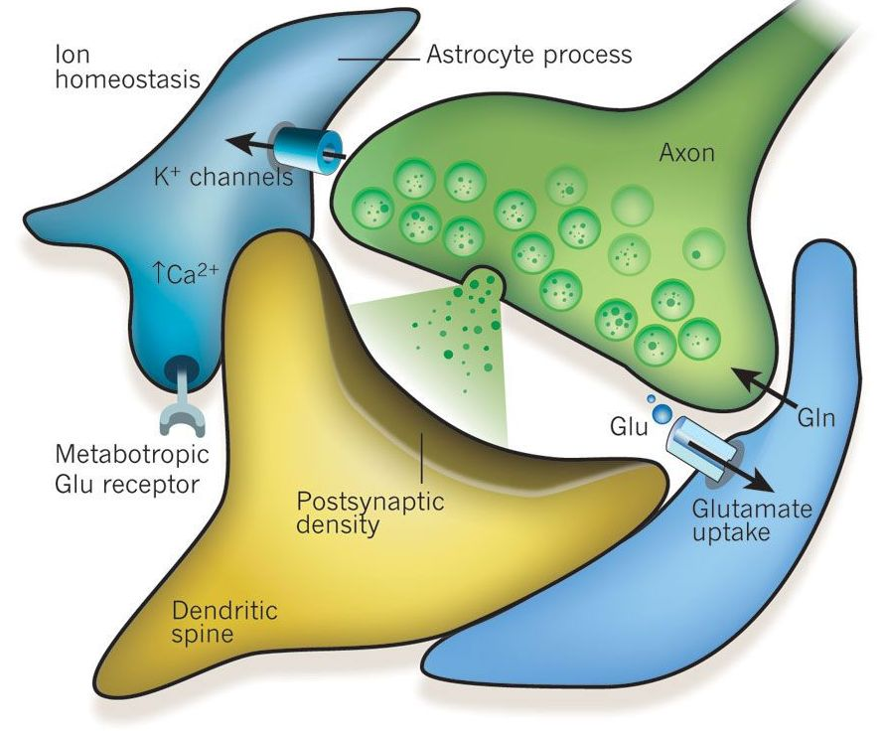
Chemical synapse – NT recycling and vesicle filling

Slide 17
Chemical synapse – Postsynaptic transmission mechanisms

Slide 18
Chemical synapse – ionotropic receptors - Glutamate receptors

Slide 19
Chemical synapse – ionotropic receptors – Glutamate receptors
Typical PSD
e.g. 350 nm diameter, 50 NMDA, 10-50 AMPA

Slide 20
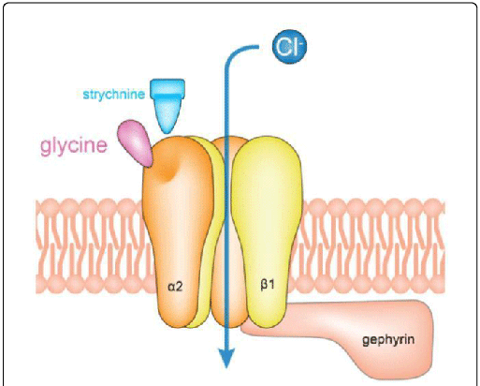
Chemical synapse – ionotropic receptors – GABA and glycine receptors

Slide 21
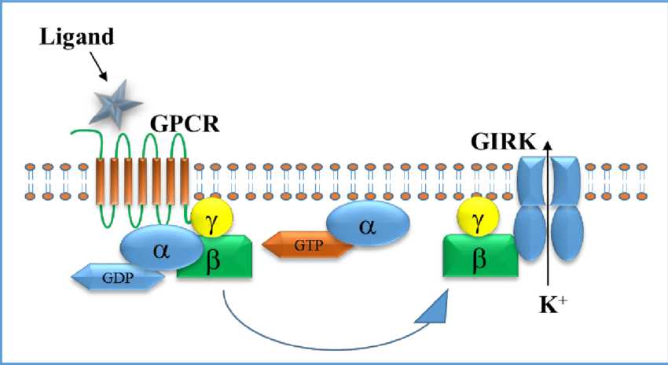
Chemical synapse – Postsynaptic transmission mechanisms - metabotropic

Slide 22
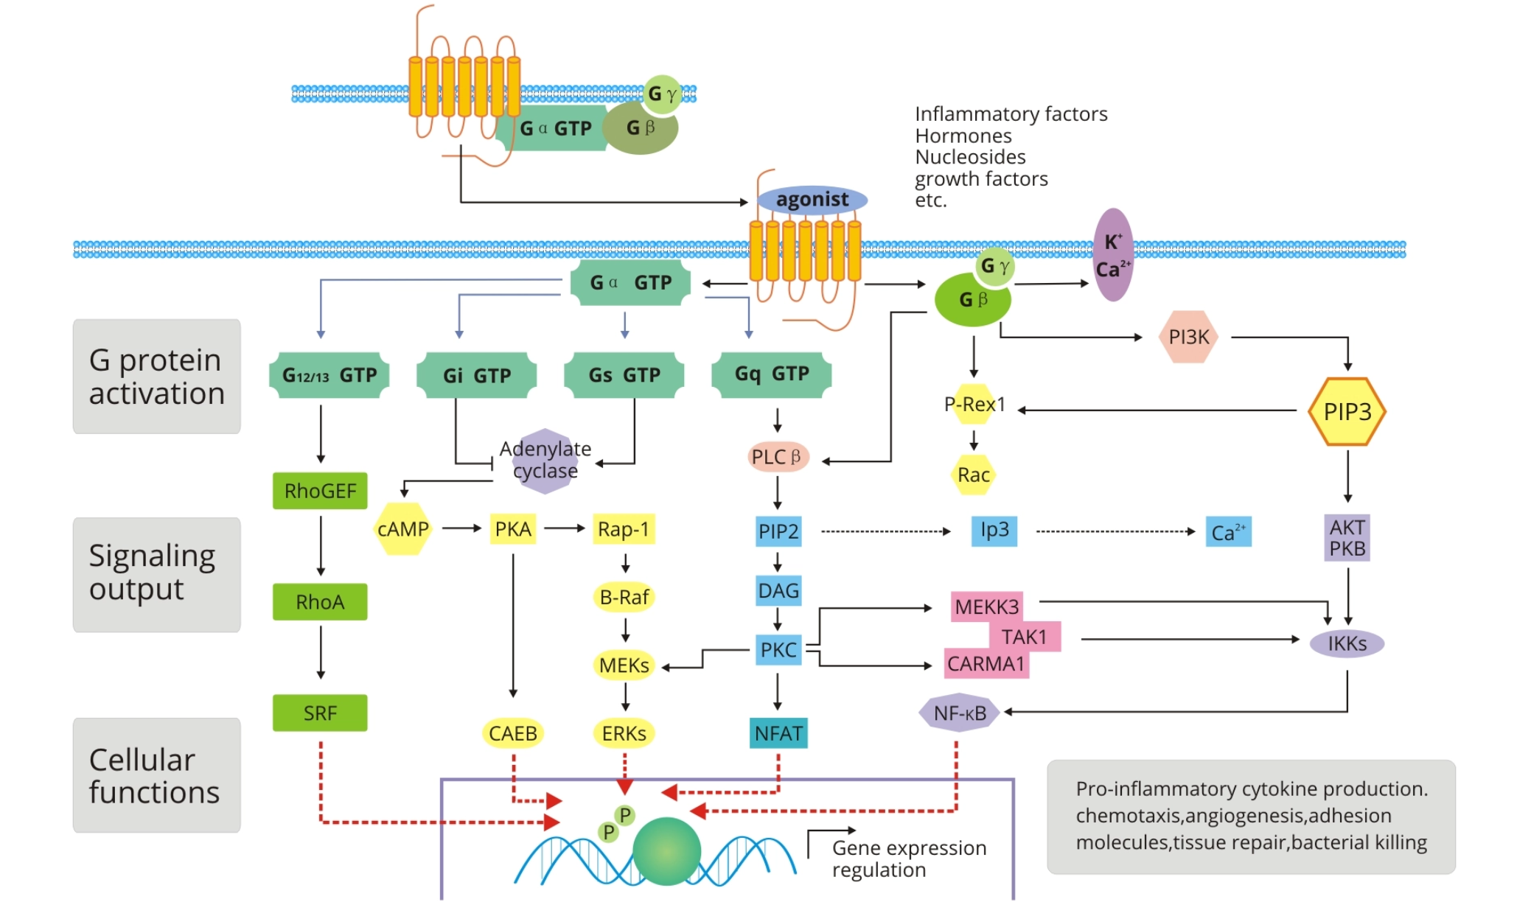
Chemical synapse – Postsynaptic transmission mechanisms - metabotropic

Slide 23
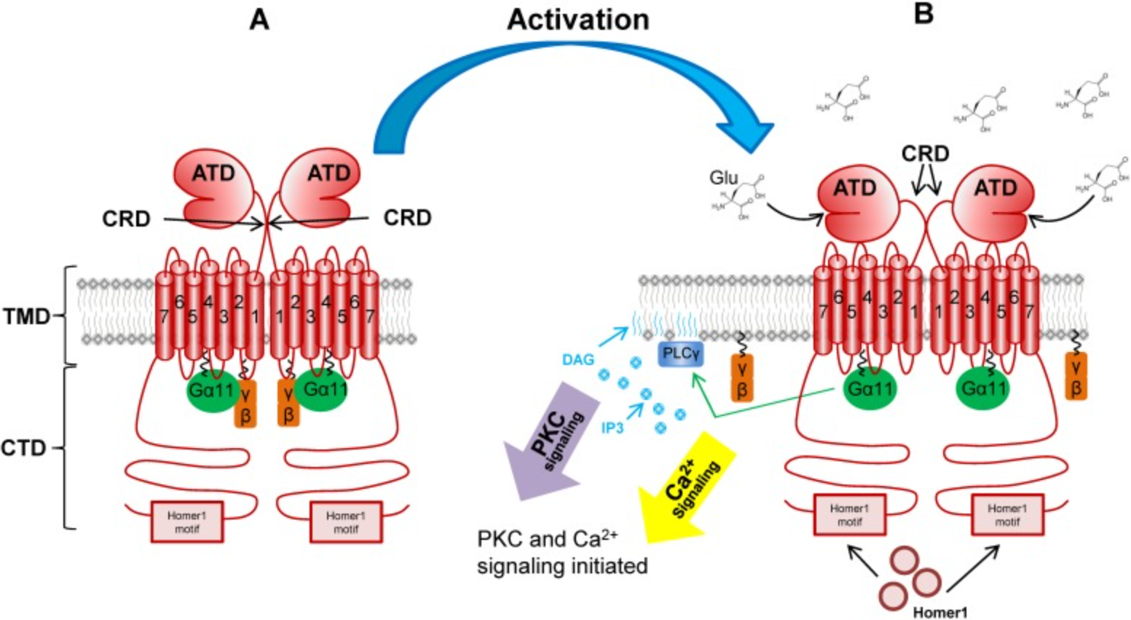
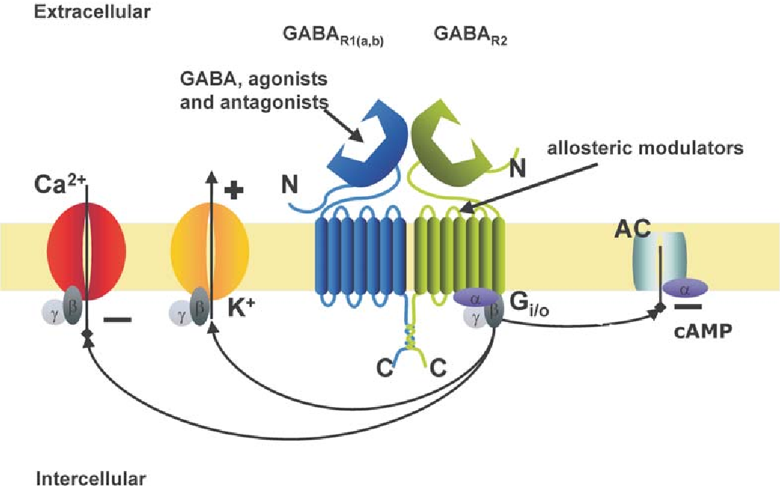
Chemical synapse – Postsynaptic transmission mechanisms - metabotropic
Main Glutamate metabotropic receptors – mGluR(1 and 5 post-synaptic, 2,3,4,6,7,8 pre-)
Main GABA metabotropic receptor – GABA_{B} (both pre-/post-synaptic)

Slide 24
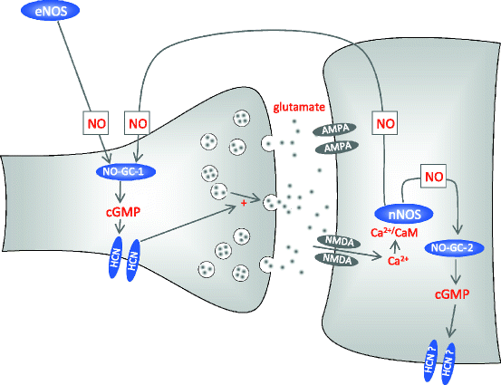
Synaptic autoregulation

Slide 25
Plasticity – long-term plasticity (LTP)

Slide 26
Plasticity – long-term plasticity (LTP)

Slide 27
Plasticity – long-term plasticity (LTP)

Slide 28
Plasticity – long-term plasticity (LTP)

Slide 29
Plasticity – long-term plasticity (LTP)

Slide 30
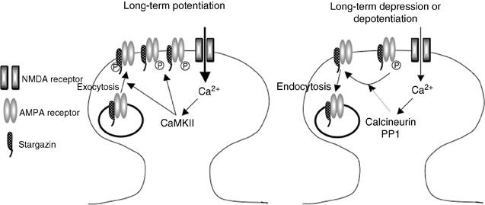
Plasticity – long-term plasticity – synaptic depression (LTD)

Slide 31
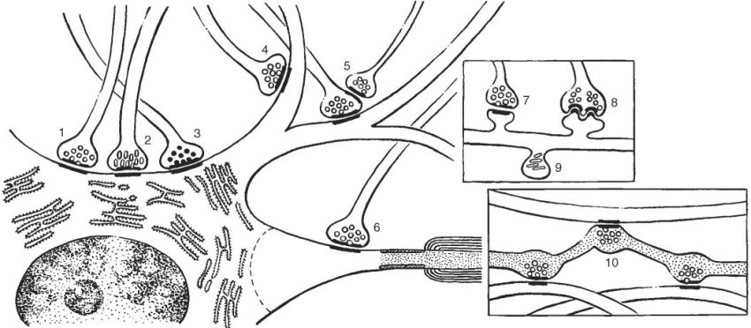
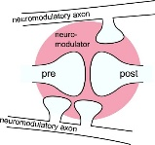
Synapse – interesting fact – “en passant“ synapse – big fraction

Slide 32
Neuromuscular junction

Slide 33
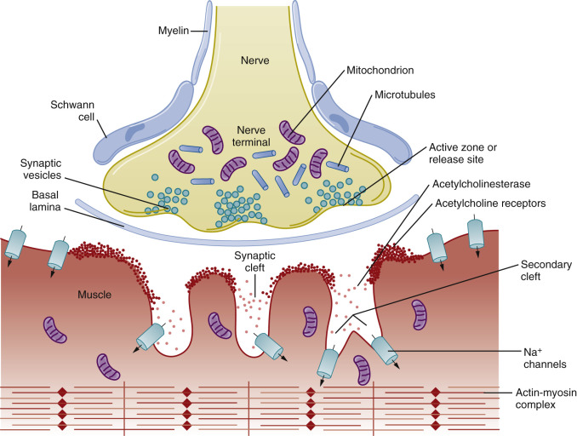
Neuromuscular junction

Slide 34
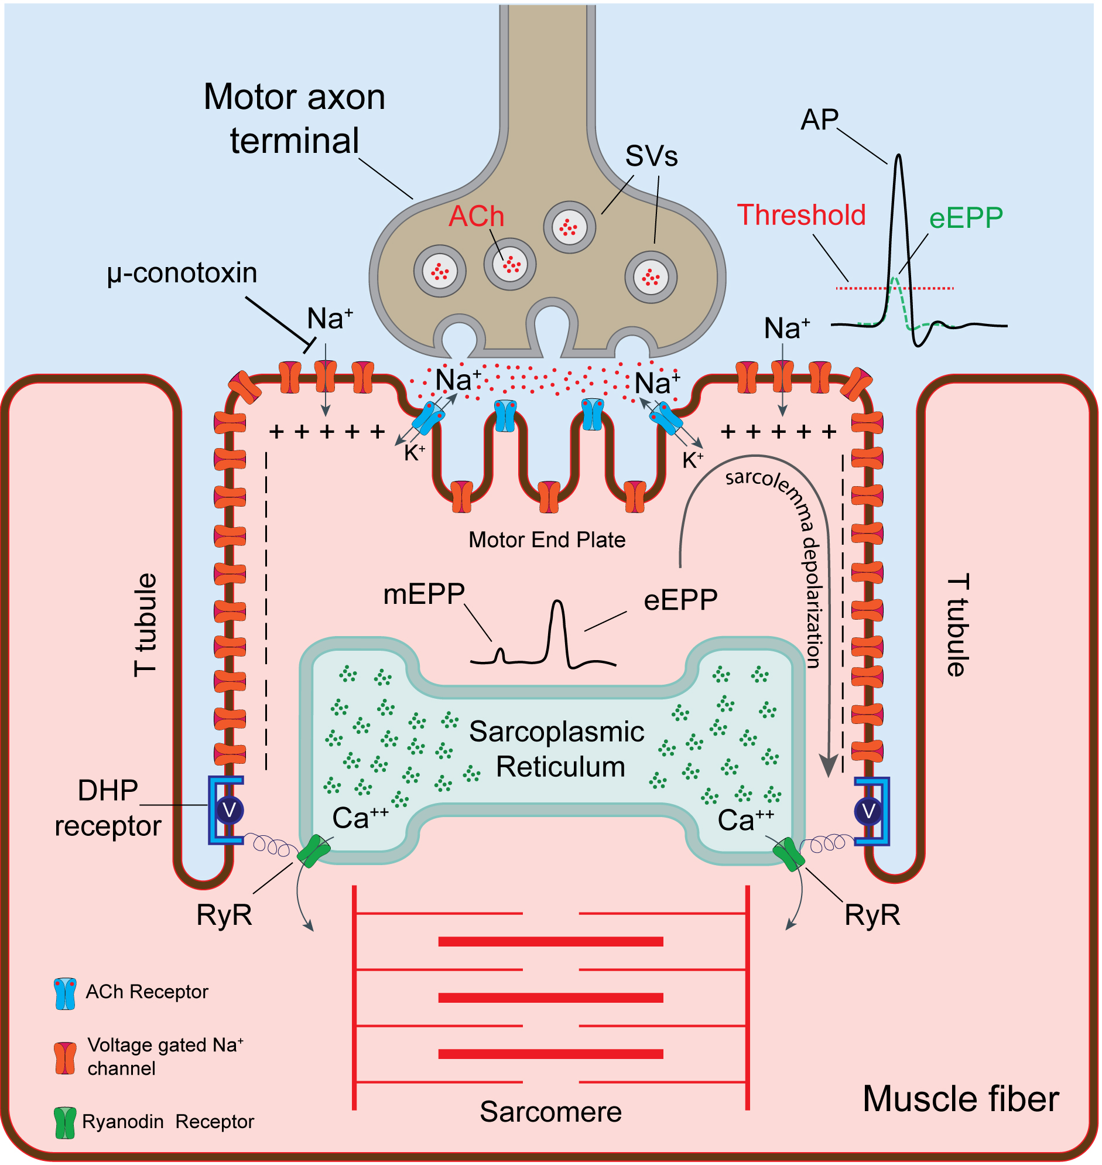
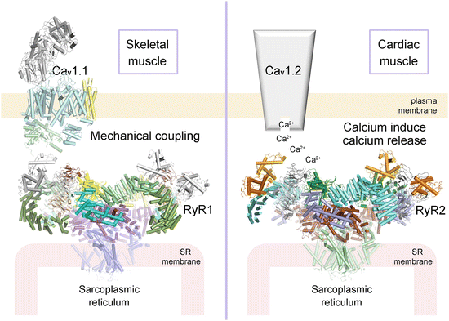
Neuromuscular junction

Slide 35
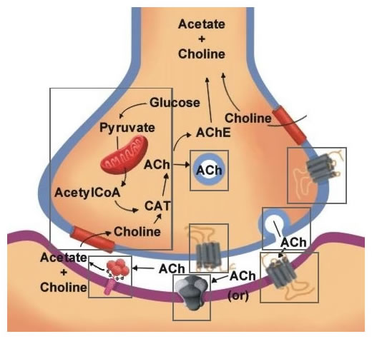
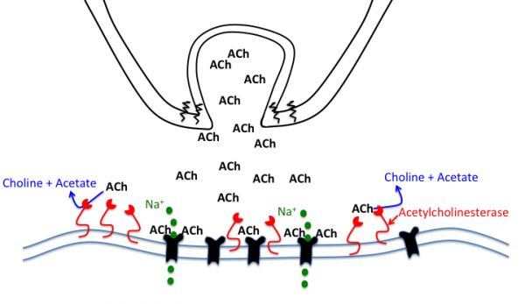
Neuromuscular junction

Slide 36
AChE – blockade, poisons, nerve gasses
Botulinum toxin (aka botulinum neurotoxin, BoNT, and sold under the trade name Botox) inhibits the release of acetylcholine at the neuromuscular junction by interfering with SNARE proteins.
Tetanus toxin, also known as tetanospasmin is a potent neurotoxin produced by Clostridium tetani and causes the disease state, tetanus. The LD₅₀ of this toxin has been measured to be approximately 1 ng/kg, making it second only to Botulinum toxin D as the deadliest toxin in the world. It differs from BoNT in a few ways, most apparently in its end state, wherein tetanospasmin demonstrates a rigid / spastic paralysis as opposed to the flaccid paralysis demonstrated with BoNT. Tetanospasmin acts similarly to BTX, but in glycinergic synapses.
Latrotoxin (α-Latrotoxin) found in venom of widow spiders causes the release of acetylcholine from the presynaptic cell. Mechanism - release of calcium from intracellular stores
Nerve agents (VX, Novichok, Sarin) disrupt the nervous system by inhibiting the function of the enzyme acetylcholinesterase by forming a covalent bond with its active site. Acetylcholine thus builds up and continues to act. This same action also occurs at the gland and organ levels, resulting in uncontrolled drooling, tearing of the eyes (lacrimation) and excess production of mucus from the nose (rhinorrhea).

Slide 37
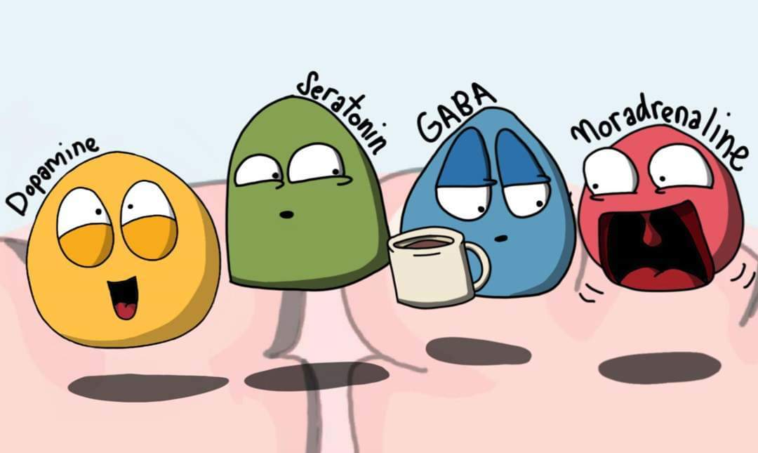
Neuromediators

Slide 38
Let‘s be more accurate
Neuromediators
Present in the presynaptic neuron
Ca2+-dependent vesicular release
Have specific postsynaptic receptors
Reuptake and degradation mechanisms
Neurotransmitters
Fast information transmittion
Often either excitatory, or inhibitory
Neuromodulators
Rather modulate target neurons‘ excitability
Often divergent projections from deep nuclei, much less local
Notes:
Úkolem jednotlivých neuronů je přijmout informaci (aktivita neurontransmiteru na synapsích – změna potenciálu vlivem chemických synapsí), tu zpracovat a vyhodnotit s přihlédnutím k podmínkám, dlouhodobé i krátkodobé historii a vytvořit výstup typu 1vs0 (akční potenciál), který je odeslán na další neurony v lokální síti, popřípadě na neurony vzdálenějších jader, popřípadě jsou jeho synapse přímo spojeny efektorem (nervosvalová ploténka). Impakt daného neuronu vysílajícího signál na příjemce signálu je dán frekvencí akčních potenciálů vyslaných po axonu na synapsi.

Slide 39
You need all of these, but not necessary to know…
Neurotransmitters
Glutamate
GABA
Glycine
Acetylcholine (PNS)
Neuromodulators
Serotonin
Dopamine
Noradrenaline (norepinephrine)
Acetylcholine (CNS)
Histamine
ATP
Neuropeptides (NPY, Substance P, Somatostatin, VIP, Orexin, opioids)
Specific cases (do not meet on of the of definition points)
Nitric oxide (NO)
Endocannabinoids

Slide 40
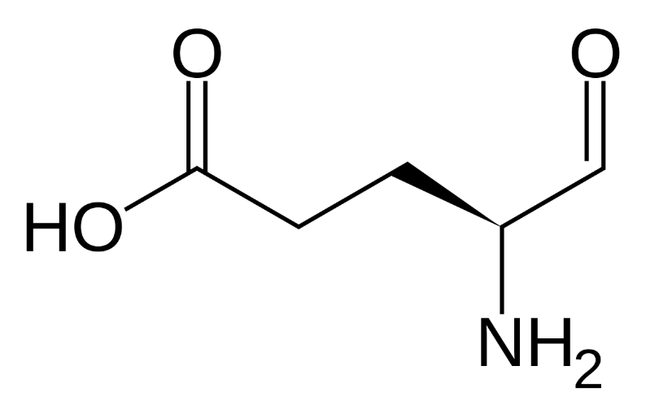
Glutamate– brief facts
Synthesis: alpha-ketoglutarate, or glutamine
Degradation: Glutamin synthetase
Reuptake: mainlyEAAT2 (GLT1), less EAAT1(GLAST),
Receptors in brain: AMPA, NMDA, kainic acid, mGluR1-5

Slide 41
Glutamate receptors

Slide 42
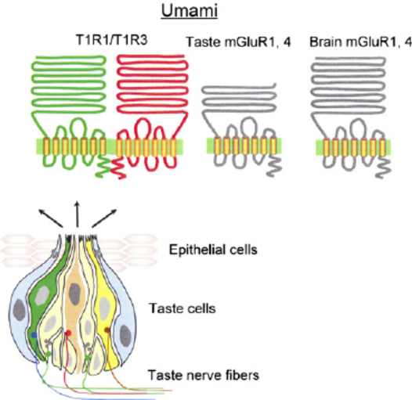
Glutamate receptors

Slide 43
Inhibition in brain (approx 15-20% of neurons)
Functions:
Regulation of neuronal excitability
Gain regulation, integration window durr (feedforward)
Keeping brain in dynamic balance (feedback)
Activation for learning (disinhibition)
Neuronal coordinations, oscillations (electrical synapses)

Slide 44
GABA (γ-aminobutyric acid)
Main inhibitory neurotransmiter in brain
Synthesis from glutamate: GAD
Receptors:
GABA_{A}
Permeable Cl⁻ channel
Inhibition via hyperpolarization or shunting (short circuiting)
Under specific conditions – can be depolarizating (rather not excitating)
Agonist: muscimol
Antagonist: biccuculine, picrotoxin
Alosteric modulators: benzodiazepines (freq), barbiturates (durr), alcohol

Slide 45
GABA (γ-aminobutyric acid)
Receptor GABA_{B}
GPCR
Inhibition via second messenger -> hyperpolarization (GIRK) or cancelling (Ca²⁺ channels)
Agonist: baclofen (used as myorelaxant)
Antagonist: saclofen

Slide 46
Clinical relevance
Epilepsy:
Low inhibition -> hyperexcitability
Lot of antiepileptic drugs boost inhibition
Anxiety:
Benzodiazepines (many types, various lifetimes)
Midazolam, diazepam, clonazepam
Adiction
Alcohol
Benzodiazepines

Slide 47
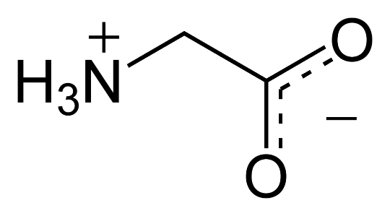
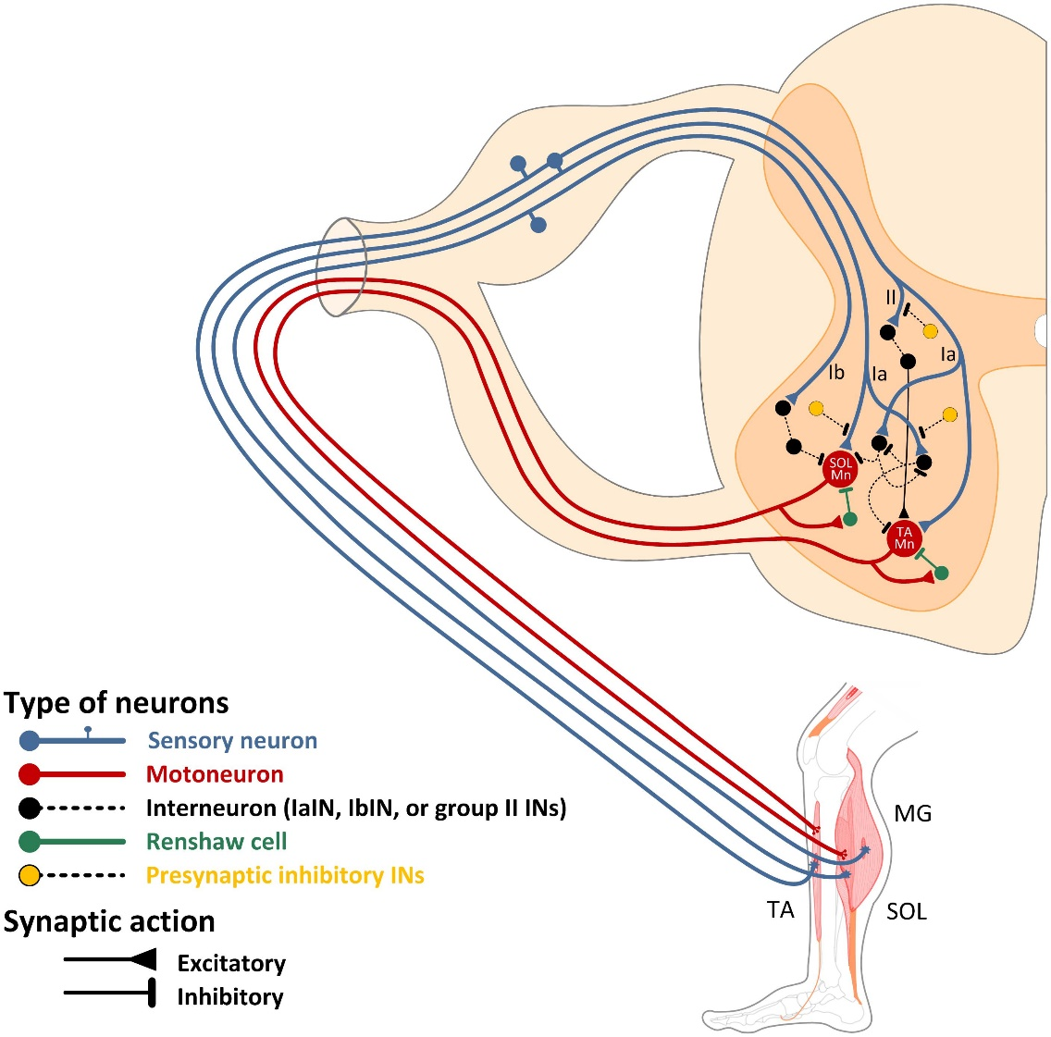
Glycine
Main inhibitory neurotransmiter in spinal cord
Receptors: GlyR
Renshaw cells control α-motor neurons
Reflex circuits
CPG circuits
NMDA coagonist
GlyR blocked by strychnin

Slide 48
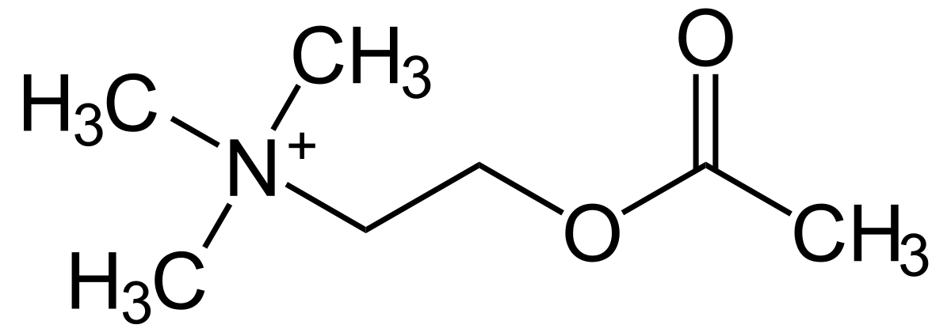
Acetylcholine (Peripheral nervous system)

Slide 49
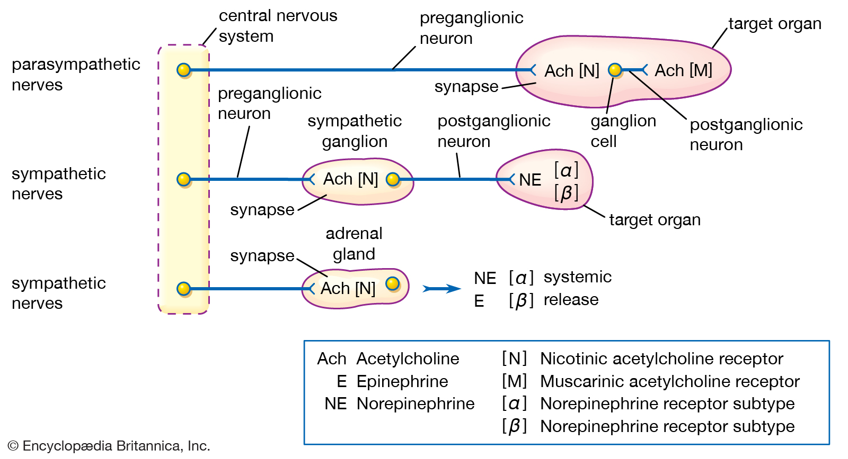
Acetylcholine (Vegetative nervous system)

Slide 50
Acetylcholine (CNS) - Localization
Projections (local action only in few structures):
ncBasalis Meynert → whole cortex (superficial layer)
-Learning, associative circuits (incoming Ach as situation significance tag)
Septal nuclei → hippocampus
-Memory modulation, reinforcement learning, theta
Pedunculopontine ns and LatDor nc
→ VTA, thalamus)
-Takes part in ARAS
-REM sleep

Slide 51
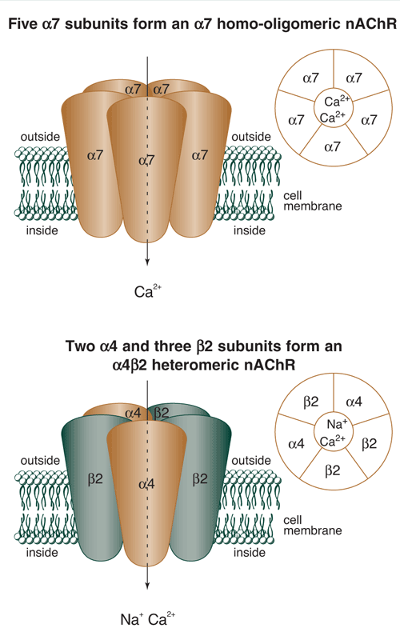
Acetylcholine (CNS) – Clinical relevance
Alzeimer disease
-Degeneration of cholinergic nuclei in basal forebrain contributes to the cognitive impairment
-AChE inhibitors crossing BBB (donepezil, rivastigmin etc..)
Nicotine addiction
-Hedonic effect via NiAChRs (containing α7 subunit) in VTA; Vareniclin

Slide 52
Katecholamines – common synthesis pathway

Slide 53
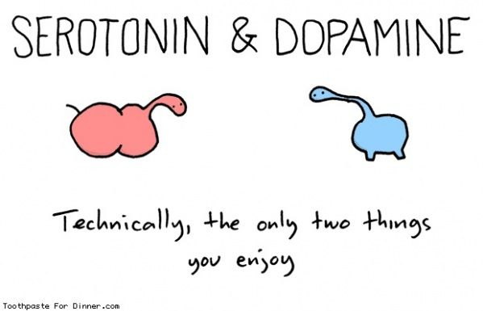
Dopamine – brief facts
Synthesis: From L-DOPA
Degradation: COMT, MAO
Reuptake: DAT
Receptors: D1-D5 (all metabotropic)
“D1-like“ (Gs) – D1, D5
- Prefrontal cortex, striatum
“D2-like“ (Gi) – D2, D3, D4
- nAccumbens, striatum, cortex

Slide 54
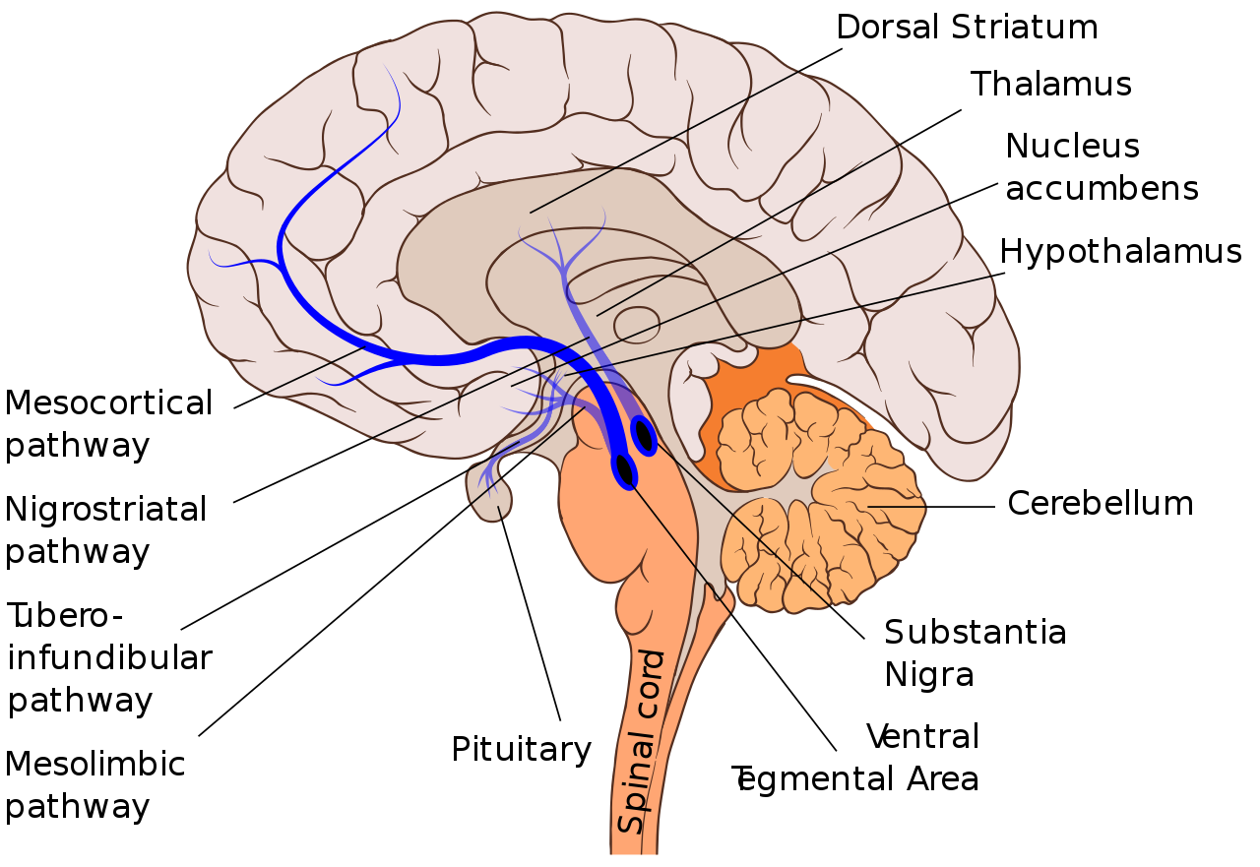
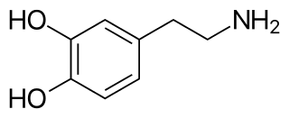
Dopamine - Localization
Four main pathways

Slide 55
Dopamine – Four main pathways
Mesocortical – (VTA → PFC)
-Working memory, oriented attention
Nigrostriatal – (SNc → Striatum)
-Regulation of the basal ganglia and
motoric functions (dysfunction in PD)
Tuberoinfundibular – (ncArcuatus → eminencia mediana)
-Prolactin secretion inhibition in posterior pituitary (neurohypophysis)

Slide 56
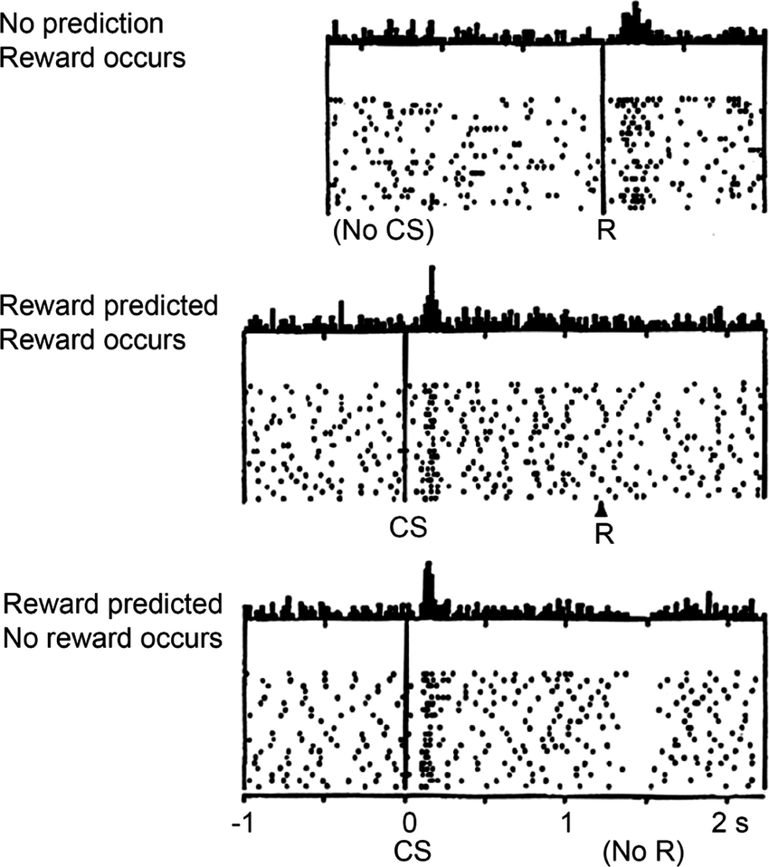
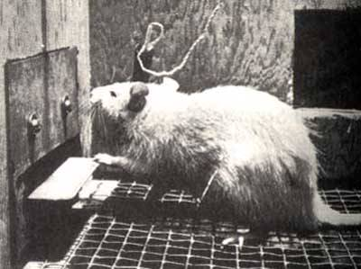
Dopamine – Four main pathways
Mesocortical – (VTA → PFC)
-Working memory, oriented attention
Nigrostriatal – (SNc → Striatum)
-Regulation of the basal ganglia and
motoric functions (dysfunction in PD)
Tuberoinfundibular – (ncArcuatus → eminencia mediana)
-Prolactin secretion inhibition in posterior pituitary (neurohypophysis)
Mesolimbic – (VTA → ncAccumbens)
-Reward prediction error (learning)
-Motivation, emotion (hedonia)
Schultz et al. 1997 (Science)

Slide 57
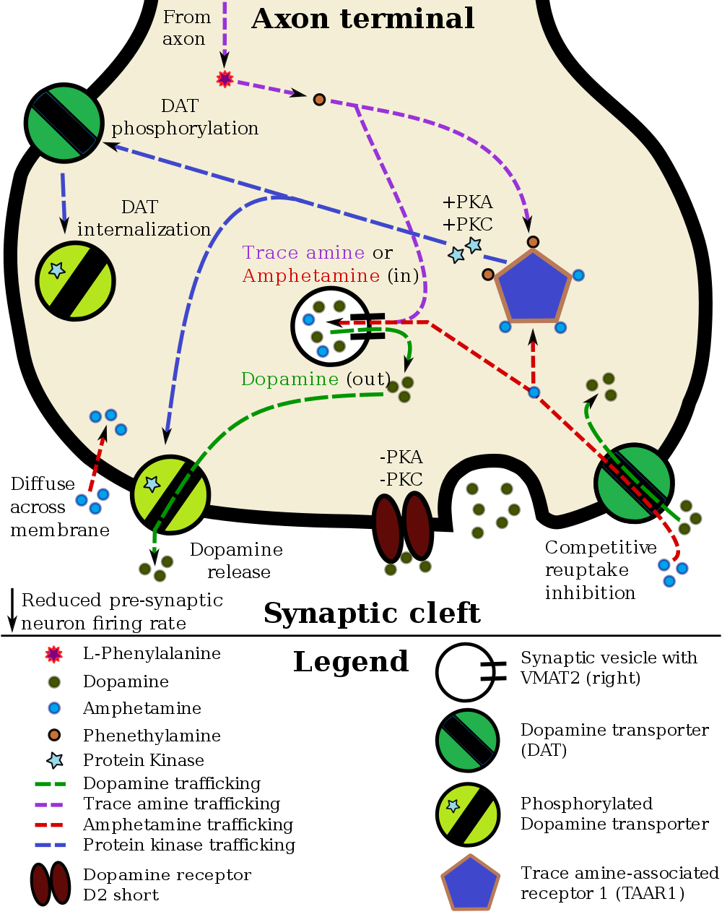
Dopamine – Clinical relevance
Shizophrenia
-D2 blocking in mesolimbic pathway (most antipsychotics) vs. metamfetamin psychosis
Parkinson disease (PD)
-Gradual loosing of dopaminergic neurons in SNc, L-DOPA to compensate (for some time)
Adiction
-Cocaine – DAT inhibitor
-Amphetamine, methamphetamin - VMAT2 substrate,
DAT inhibitor, TAAR1 agonist
ADHD (attention-deficit hyperactivity disorder)
-Ritalin (methyphenidate) – weak DAT inhibitor

Slide 58
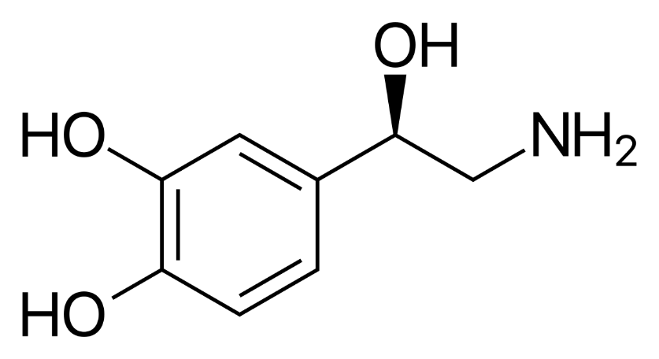
Noradrenaline (norepinephrine) – brief facts
Synthesis: From dopamine
Degradation: COMT, MAO
Reuptake: NET
Receptors in brain: α1, α2 , β1, β2 (all metabotropic)
Significant: α2(Gi) (presynaptic autoinhibition), β1(Gs) cortex

Slide 59
Noradrenaline (norepinephrine) – Localization and function
Sole source in CNS: Locus ceruleus
Function:
Ascending:
-arousal (cortex)
-cognitive processes orchestration
Descending:
-nociceptive transmition modulation
in spinal cord
%%% postganglionic transimtter of
Sympathetic nervous systém
Clinical relevance:
Some antidepressants NET blockers

Slide 60
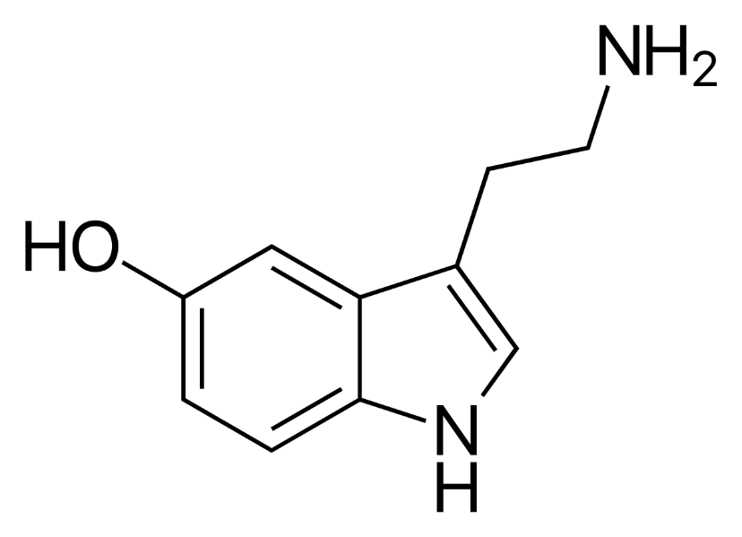
Serotonin (5-hydroxytryptamin) – brief facts
Synthesis: Tryptophan
Degradation: MAO A
Reuptake: SERT
Receptors: 5-HT1 – 5-HT7 (all metabotropic except 5-HT3) and their subtypes
Important:
5-HT1a: mood regulation, agonists do anxiolysis
5-HT1b,d: vasoconstriction, triptans – antimigraine drugs
5-HT2a: agonists produce halucinations (LSD, psilocybin)
5-HT3: antagoninsts (setrons) are very potent antiemetics (used e.g. in oncology)
(vagal afferents, the solitary tract nucleus (STN), and the area postrema)

Slide 61
Serotonin (5-hydroxytryptamin) – Localization
Raphe nuclei
Function:
Ascending:
-Affect (noun) and memory
Descending:
-nociceptive transmition modulation
in spinal cord

Slide 62
Serotonin – Clinical relevance
Depressive disorders and anxiety
-Most antidepressant drugs are “selective serotonin reuptake inhibitors“ (SSRI), SERT inhibitors
-Monoamine theory of depression???

Slide 63
Serotonin – Clinical relevance
The “what-you-are-usually-expected-to-answer theory“ vs. the latest research

Slide 64
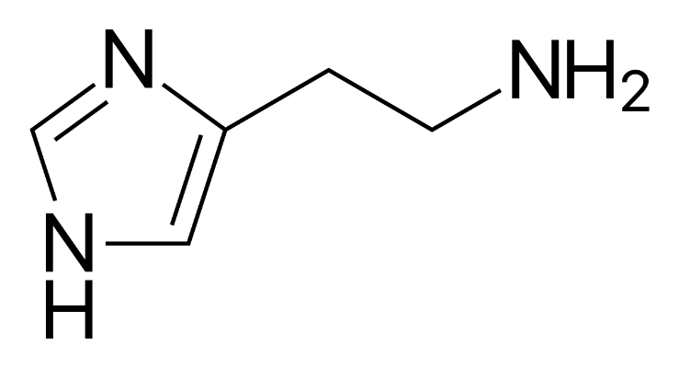
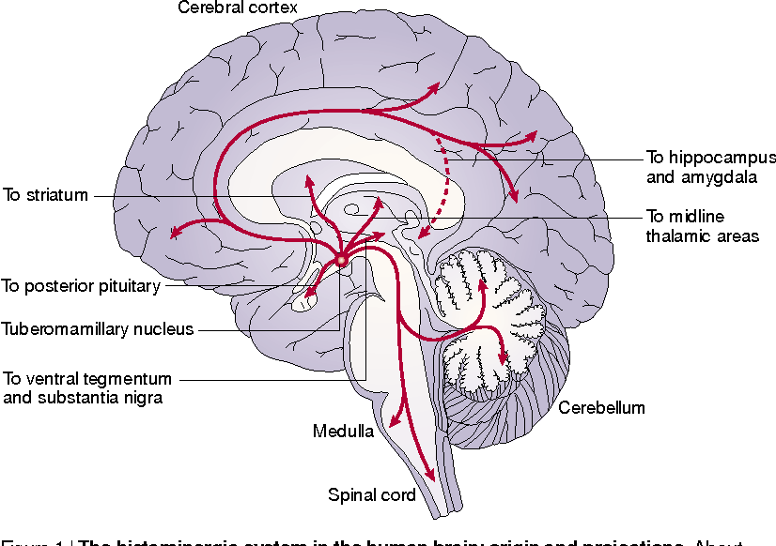
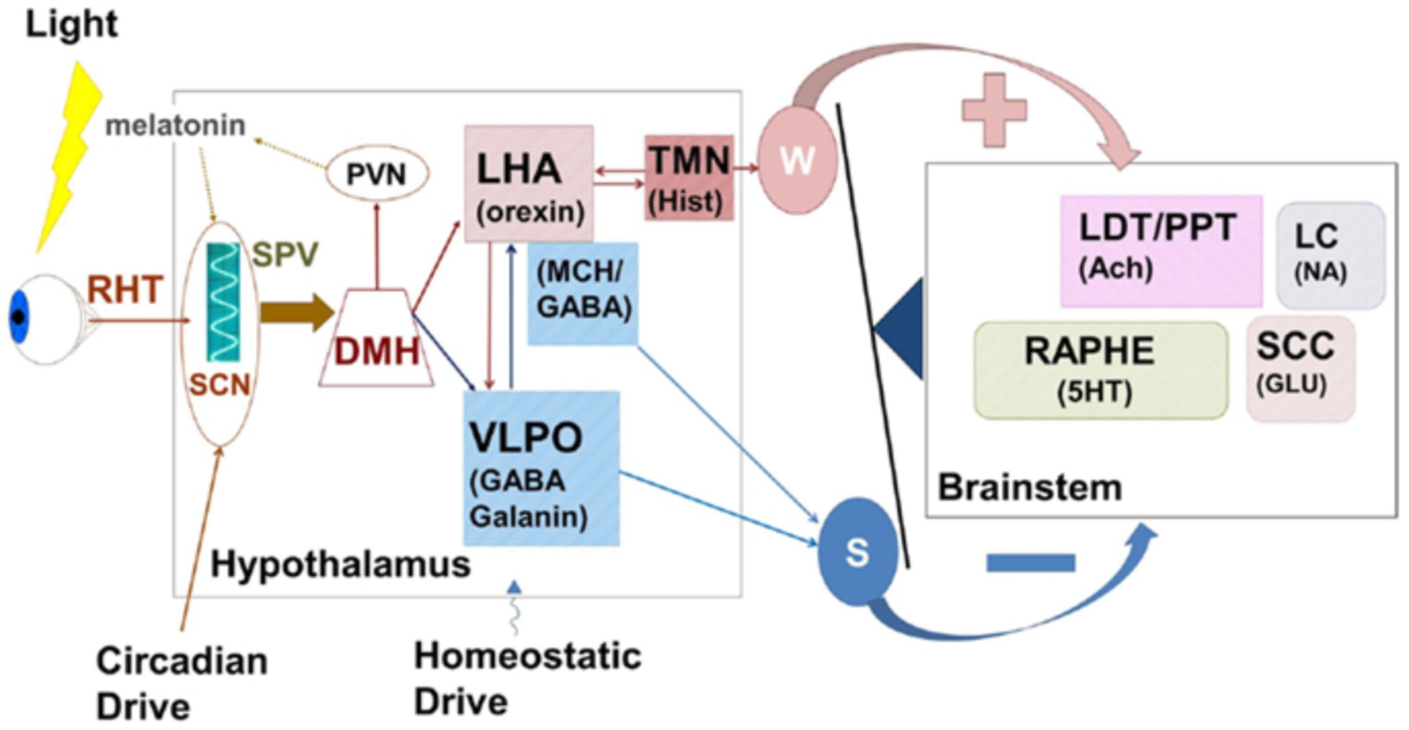
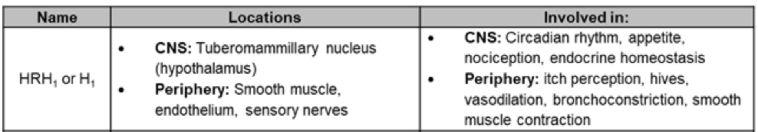
Histamine
About 64,000 histamine-producing neurons,
all in the Tuberomamillary nc project to major parts of the cerebrum, cerebellum, posterior piuitary and the spinal cord.

Slide 65

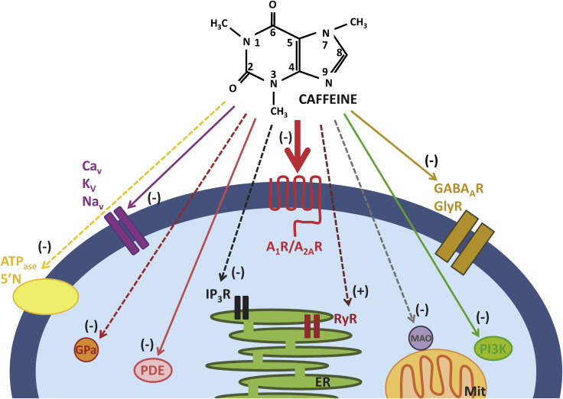
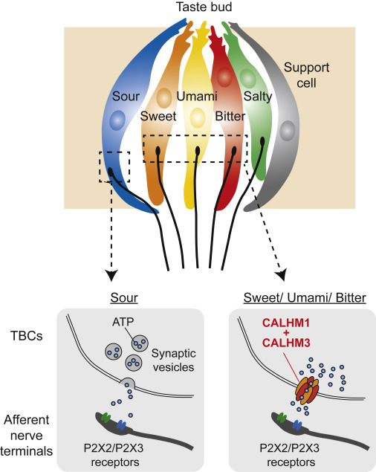
ATP, adenosine – just a note
Purinergic receptors:
o P1 (A1-Gi, A2-Gs) //adenosin
o P2Y (Gi/Gq) //ATP

Slide 66



NPY, Substance P
Substance P:
- Pain regulation in periphery (“P“ for pain)
- CNS – vazodilatation, inflamation, pain
Receptors: Y1 (Gi), Y2(Gi), NK1

Slide 67


Somatostatin, VIP, Orexin
Somatostatin and VIP – neurvascular coupling
-vasocontriction x vasodilatation
Orexin system in hypothalamus integrates
Sleep and energy needs of the organism
Hunger and satiety; Ghrelin vs Leptin

Slide 68

Opiates
Enkephalin
Binding to δ receptors
Pain modulation;
enkephalin-producing neurons in spinal cord

Slide 69
Opiates
Β-endorphin (endogeneous morphin)
Binding mainly to μ receptors, less to δ receptors
Pain modulation;
Opioid receptors (All Gi/o GPCRs)
μ(MOR)
Agonists: endorphins, morphin, heroin=diacetylmorphin
Agonist bring strong anlgesia, or euphoria
Natural pain regulation system; stronly expressed e.g. in spinal cord dorsal horns, but also in cortex, thalamus, ventral striatum
Antagonist: Naloxone
δ(DOR)
Agonists: enkephalins, to less extent β-endorphin
Agonist bring strong anlgesia, or euphoria
Natural pain regulation system; antinociceptive effect partially via brainstem – through erotonergic system – dorsal raphe nuclei

Slide 70
Opiates
κ(KOR)
Agonists: dynorphins
Medium antinociceptive effect, central activation-> dysphory (can‘t get high by tramadol)
Pain
Opioids used in treatment of strong pain
Fentanyl (100x more powerful agonist to μ-receptors compared to morphin)
Risk of breathing attenuation
Pain modulation by opioids in the spinal cord dorsal horns

Slide 71

Opiates
Addiction
Heroin
Along with psychical addiction, strong physical addiction
Increased expression of OR in periphery -> withdrawal -> pain
Therapy: going to weaker agonists: methadon, buprenorphin-> cessation
Alcohol
Alcohol stimulates β-endorphin release (not the main mechanism of alcohol addiction)

