Slide 1
Pregnancy and sex hormones
MUDr. Tereza Kratzerová, Ph.D.

Slide 2
Regulation of sex hormones - male
_
GnRH (pulsative delivery 1-3 hours)
_
Gonadotropes of the anterior pituitary lobe
FSH
LH
_
Leydig cells
testosteron
Inhibin
Sertoli cells seminiferous tubules
Spermatogenesis

Slide 3
Testosterone
Hair distribution
Balding
Voice
Skin and acne
Protein metabolism and muscle development
Bone growth
Effect on basal metabolism
Effect on red blood cells
Effect on electrolytes and water balance
Behavior (dominance, aggression, sexual behavior…)

Slide 4
Regulation of sex hormones - female
GnRH (pulsative delivery 1-3 hours)
Cyclic activity of hypothalamic GnRH neurons
Follicular phase
Gonadotropes of the anterior pituitary lobe
_
FSH
LH
_
Theca interna
testosterone
Inhibin
Converted to estrogens (estradiol) by aromatase enzymes in follicular granulosa cells
Stimulation of LH receptor production in granulosa cells
Endometrial growth and watery cervical secretion
Maturation of follicles

Slide 5
Regulation of sex hormones - female
GnRH (pulsative delivery 1-3 hours)
Cyclic activity of hypothalamic GnRH neurons
Ovulation =
Change negative feedback to positive
Gonadotropes of the anterior pituitary lobe
+++
LH
Rupture of the most developed follicle and release of the egg
FSH
_
Theca interna
testosterone
Inhibin
Converted to estrogens (estradiol) by aromatase enzymes in follicular granulosa cells
Stimulation of LH receptor production in granulosa cells
Endometrial growth and watery cervical secretion
Maturation of follicles

Slide 6
Regulation of sex hormones - female
GnRH (pulsative delivery 1-3 hours)
Cyclic activity of hypothalamic GnRH neurons
Luteal phase
Pregnancy
hCG (similar to LH)
Gonadotropes of the anterior pituitary lobe
-
-
-
LH
Hypertrophy of granulosa cells - formation of a corpus luteum
FSH
After about 14 days, the inability of LH to retain the corpus luteum
Progesterone estrogens inhibin
Luteolysis
Progesterone and estrogens
Endometrial growth and dense cervical mucus
menstruation

Slide 7
Menstrual cycle
ttps://antranik.org/the-menstrual-cycle/

Slide 8
Estrogen
Stimulates uterine growth
the development of breasts
relaxation of ligaments
fetal development
Effect of estrogens on protein deposition
Effect of estrogens on body metabolism and on fat deposition (buttocks and thighs)
Effect of estrogens on the skin (soft, smooth, thicker, more vascular)
Effect of estrogens on electrolyte balance (chemical similarity to adrenocortical hormones- caused sodium and water retention- normally slight effect- during pregnancy – severe body fluid retention)

Slide 9
Progesterone
Syncytiotrophoblast - large amounts of progesterone
Helps prepare the endometrium for implantation - decidual cells - an embryo nutrition
Reduces the excitability of the uterus - prevents uterine contractions
Stimulates the development of breast tissue

Slide 10
Pregnancy
Changes not only endocrine

Slide 11
Pregnancy and hormones
http://medquarterly.com/mq88/MQIMAGES/Notes/Biochemistry/Parturition_html_3a9c608a.png

Slide 12
Placenta
endocrine organ - human chorionic gonadotropin (hCG), human placental lactogen (human chorionsomatomamotropin, HCS), progesterone, estrogen and relaxin.
corpus luteum graviditatis - secreting estrogen, progesterone and relaxin - especially in early pregnancy
After 6 weeks of pregnancy - sufficient estrogen and progesterone synthesis of maternal and fetal precursors in the placenta (takes over the function of the ovaries - luteal function begins to diminish after the 8th week of pregnancy.
Ovariectomy before the sixth week of pregnancy leads to abortion, but after the sixth week of pregnancy has no effect on pregnancy.

Slide 13
The interplay of hormonal production of fetal, maternal and placental
Mother - Blood
Placenta
Fetal adrenal gland
Cholesterol
Progesterone
Cholesterol
Pregnenolone
Progesterone
DHEAS
16-OHDHEAS
Cortisol, corticosterone
Estradiol
Estriol
DHEAS
16-OHDHEAS
Estriol

Slide 14
Human chorionic gonadotropin (hCG)
Syncytiotrophoblast
Produced since fertilization
The signal for the corpus luteum, that fertilization occurred - forces him to maintain the production of estrogen and progesterone ... later production of estrogen and progesterone in the placenta
prevents menstruation
hCG is a glycoprotein - a and b subunits.
a subunit of hCG is identical to a subunit of LH, FSH and TSH
primarily the effect of LH
The liver and kidneys of the fetus - a small amount of hCG
Use in pregnancy tests
tumor marker

Slide 15
Human chorionic somatomamotropin, human placental lactogen(hCS)
lactogenic and growth-stimulating effect
HCS structure is similar to the structure of human growth hormone (STH) - similar effects STH - maternal gestational growth hormone
retention of nitrogen, potassium and calcium
lipolysis and decrease glucose utilization in pregnancy - fetal glucose supply – gestational diabetes
HCS amount produced is proportional to the placenta, which normally weighs 1/6 fetal weight - low level hCS - placental insufficiency

Slide 16
Relaxin
Helps maintain pregnancy - inhibition of contractions of the myometrium
facilitates childbirth - induces relaxation of the pelvic ligaments and soften the cervix
Corpus luteum and placenta

Slide 17
Other hormonal changes during pregnancy
Pituitary gland – enlargment - approximately 50% ↑ corticotropin, thyrotropin ↑, ↑ prolactin, LH and FSH completely inhibited by estrogen and progesterone from the placenta
↑ glucocorticoids – AMA for fetus?
↑ Aldosterone - sodium resorption - hypertension
↑ thyroxin - thyroid enlargement - Thyroid effect of hCG (human chorionic thyrotropin +)
↑parathormon - especially the lack of calcium during lactation

Slide 18
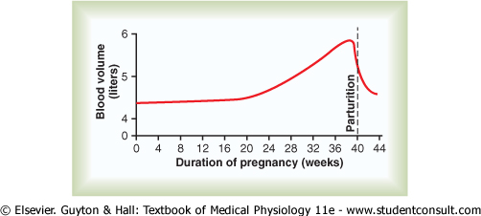
Blood circulation
increased heart rate
increased cardiac output (up to 30-50%)
increase in volume of fluids - higher plasma volume (50%), increased erythropoiesis (25%) → decrease in Hb and hematocrit
oppression of the pelvic veins by growing uterus, the deterioration of the flow of blood from the lower extremities
Anemia
thrombophilia

Slide 19
Pregnancy and blood clotting
High risk of bleeding during childbirth
Normal blood loss during childbirth approx 0.5 liters
Increase blood volume during pregnancy
Increase blood clotting (→ risk of blood clots in users of hormonal contraception)

Slide 20
Distribution of cardiac output (%)
Organ system | Fetus | Adult
Lung | 6 | 100
Heart | 5 | 5
Kidneys | 2 | 20
Brain | 20 | 20
Musculoskeletal sys. | 20 | 20
Splanchnic sys. | 7 | 30
Placenta | 40 | -
Dle Preston a Wilson 2013

Slide 21
Transport of oxygen through the placenta
Placenta - functionally serves among other things as "the lungs of the fetus" (resemblance including hypoxic vasoconstriction)
Oxygen transport - simple diffusion
Lung
pO₂ – alveoli 100mmHg
pO₂ - venous blood 40mmHg
dO₂ - pressure gradient 60mmHg
Placenta:
pO₂ - placental sinuses 50mmHg
pO₂ - Fetal venous blood 30mmHg
dO₂ - pressure gradient 20mmHg

Slide 22
Ensuring fetal oxygen saturation
1. Fetal hemoglobin
2. Higher concentration of Hb in the fetal blood (50% more than for an adult)
3. Double Bohr effect - Hb transports more oxygen at lower pCO2 than at higher pCO2
(The fetus gives mother CO2→ pCO2 in the fetal blood decrease and pCO2 in maternal blood increases)

Slide 23
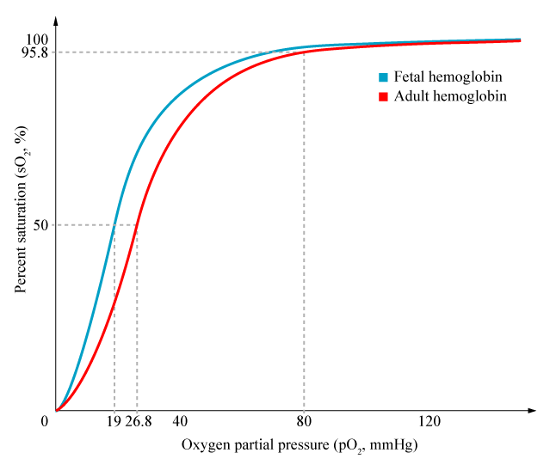
Dissociation curve - fetal and adult hemoglobin
http://upload.wikimedia.org/wikipedia/en/f/fb/HbA_vs_HbF_saturation_curve.png

Slide 24
Gestational Diabetes
Insulin resistance caused by HCS, cortisol and growth hormone
Approximately 5% of pregnancies (15%)
Excess glucose - increased production of fetal insulin - hyperplasia of the β cells of the fetus - threatening hypoglycemia after the birth and brain damage
Newborns are often makrosomic (insulin promotes the growth of the fetus) - placenta may not cope with large demands - threatening fetal death

Slide 25
Parturition = start of "single" life

Slide 26
Parturition
oxytocin receptors (estrogen…) + oxytocin
prostaglandins
uterine contractions
Dilation of the cervix and vagina distension
Impulses from the cervix and vagina
oxytocin

Slide 27
Hormonal birth control
https://humanphysiology2011.wikispaces.com/15.+Reproductive+Physiology

Slide 28
Oxytocin
Love hormone, child care, relationship
neurohypophysis
Parturition
Ejection of milk
Positive feedback

Slide 29
Lactation

Slide 30
Production and milk ejection
baby suckles
mechanoreceptors of the nipples
Hypothalamus
The anterior lobe of the pituitary gland Posterior lobe of the pituitary gland
Prolactin Oxytocin
Production of milk Contraction of myoepithelial cells
surrounding the ducts
Ejection of milk
+/-
emotional stimulus

Slide 31
Lactation
https://humanphysiology2011.wikispaces.com/15.+Reproductive+Physiology

Slide 32
Antibody protection of newborns
https://humanphysiology2011.wikispaces.com/15.+Reproductive+Physiology

Slide 33
Pregnancy and immune system
Fetus = Foreign tissue in the mother's body
Preventing "rejection" of the fetus
Placental trophoblast - separates the tissues of mother and child - do not express MHC class I and II. classes
Trophoblast HLA-G
the immune system of the mother is during pregnancy dampened - low antibody production in pregnancy ... × risk of sepsis after childbirth
Different manifestations of autoimmune disease during pregnancy and after childbirth
preeclampsia
Rh incompatibility - 80% Rh + 20% Rh- disintegration fetal erythrocytes

Slide 34
Thank you for your attention

