Slide 1
Electroencephalography (EEG)
Jan Kudláček
2022-04-08
kudlaceksystem@gmail.com

Slide 2
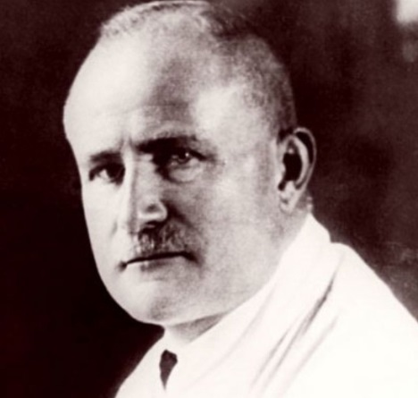
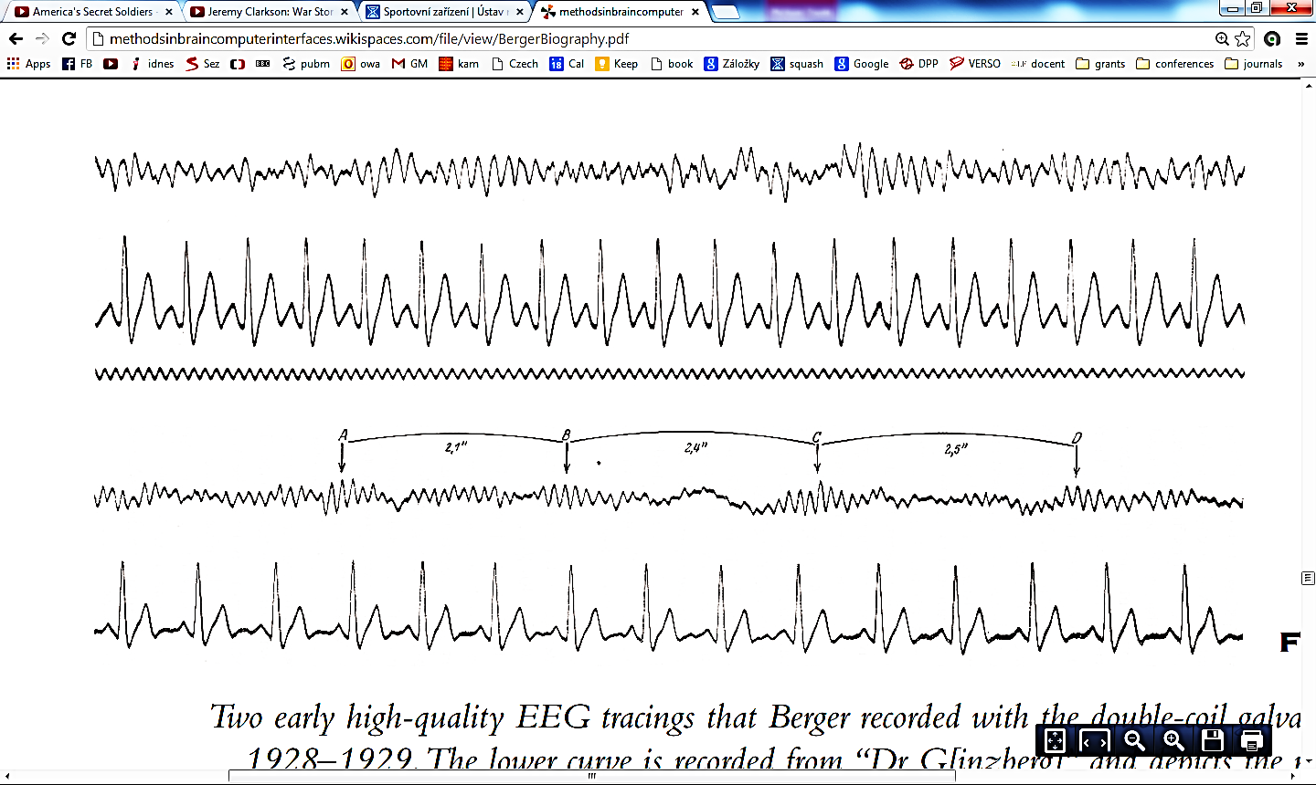
Electroencephalography (EEG)
Electrical activity of the brain
100 μV
1 s
Hans Berger (1873-1941)
Alpha activity

Slide 3
Electroencephalography(EEG)
Recording of electrical potentials caused by the brain activity
  Electroencephalograph – instrument
  Electroencephalogram – recording
Scalp (surface) EEG records the activity of the cortical neurons in the vicinity of the electrode
Method of functional examination
Diagnosis of brain disorders
  Epilepsy
  Sleep disorders
Weak signal
  In the order of 100 µV
  E.g. ECG is around 1 mV

Slide 4
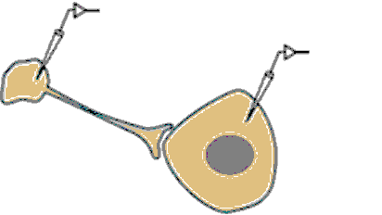
Neurophysiology of synaptic transmission
Presynaptický
neuron
Postsynaptický
neuron

Slide 5
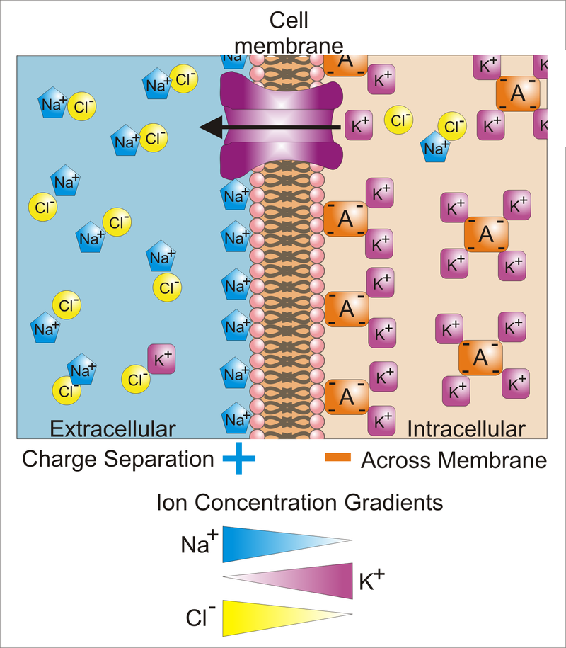
Neurophysiology of synaptic transmission
Presynaptic
neuron
Postsynaptic
neuron

Slide 6
Neurophysiology of synaptic transmission
Action potential
Presynaptic
neuron
Postsynaptic
neuron

Slide 7
Neurophysiology of synaptic transmission
Action potential
Excitatory postsynaptic potential (EPSP)
Presynaptic
neuron
Postsynaptic
neuron

Slide 8
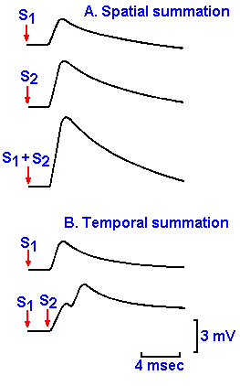
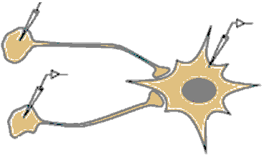
Spatial summation of postsynaptic potentials
Presynaptic
neuron I
EPSP1
EPSP2
Presynaptic
neuron II
Sum
Postsynaptic
neuron

Slide 9
Temporal summation of postsynaptic potentials
Presynaptic
neuron
Postsynaptic
neuron
EPSP2
EPSP1
Sumace
Presynaptický
neuron

Slide 10
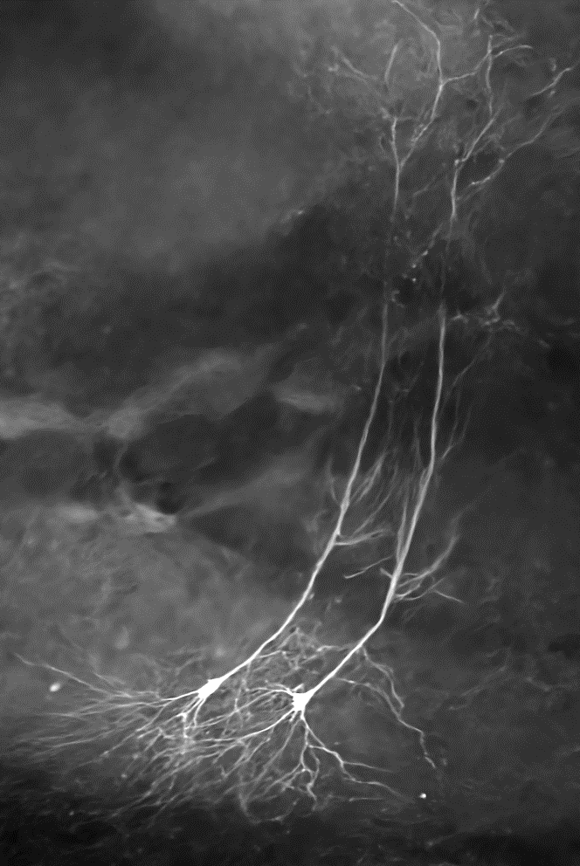
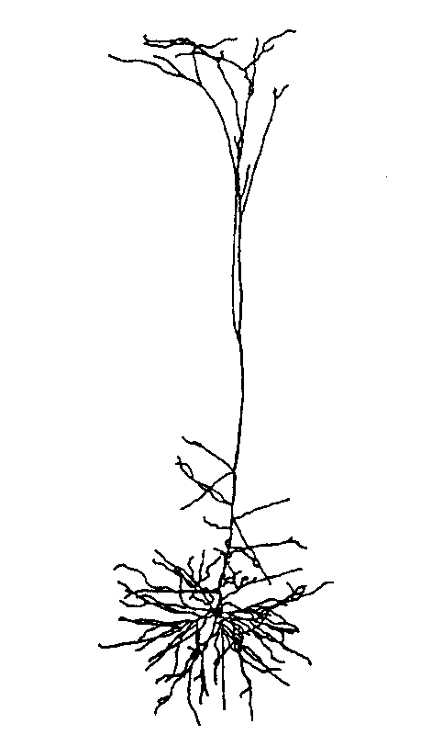
Cellular mechanisms of the EEG
Pyramidal
neuron
Two pyramidal neurons
Main source of EEG
  Synaptic activity on pyramidal neurons
Pyramidal neurons
  Main projection neurons in the cortex
  Apical dendrites perpendicular to the brain surface
Extracellular currents and electric fields
  Synaptic activity
  No contribution of action potentials
Apical dendritic tree
Soma

Slide 11
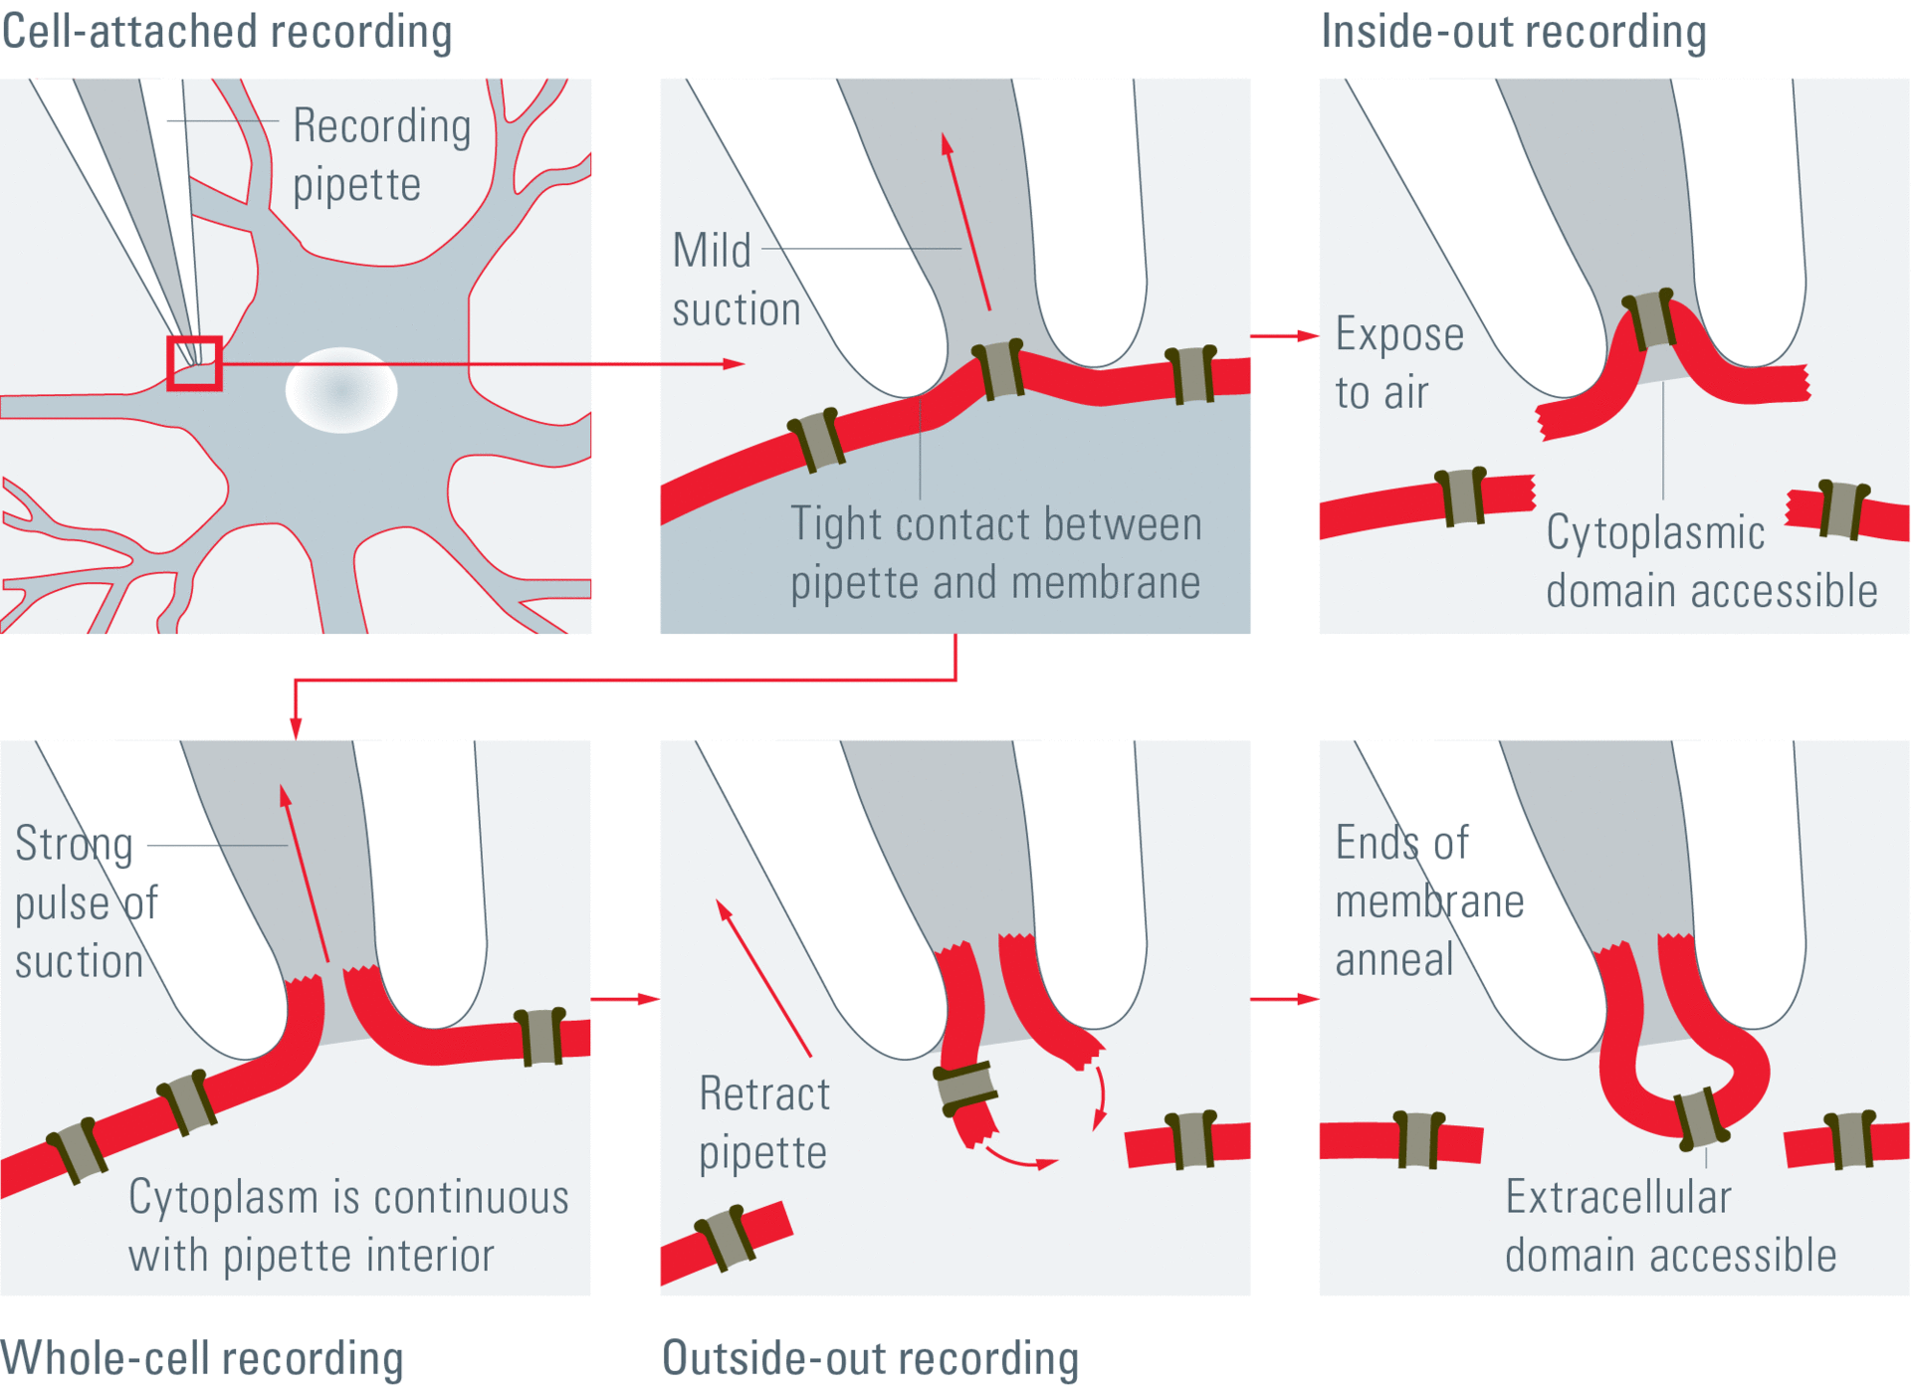
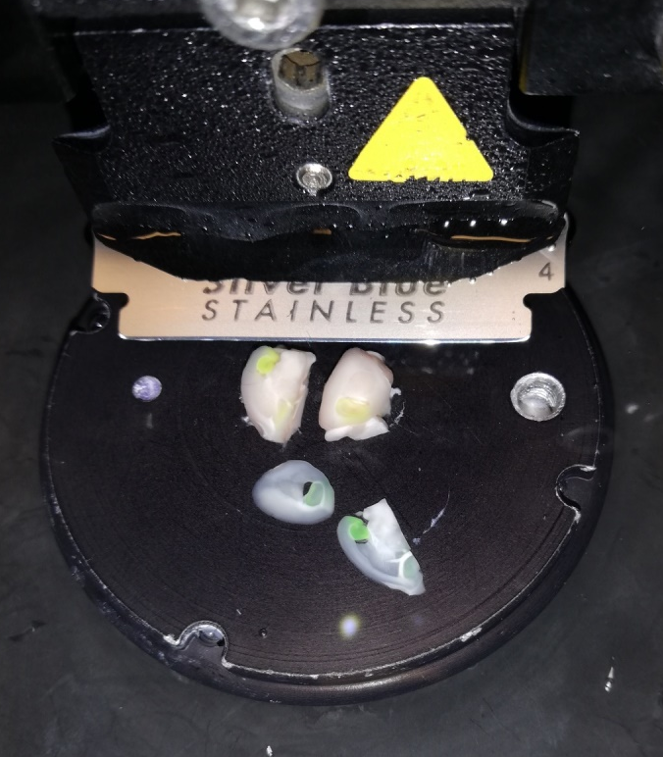
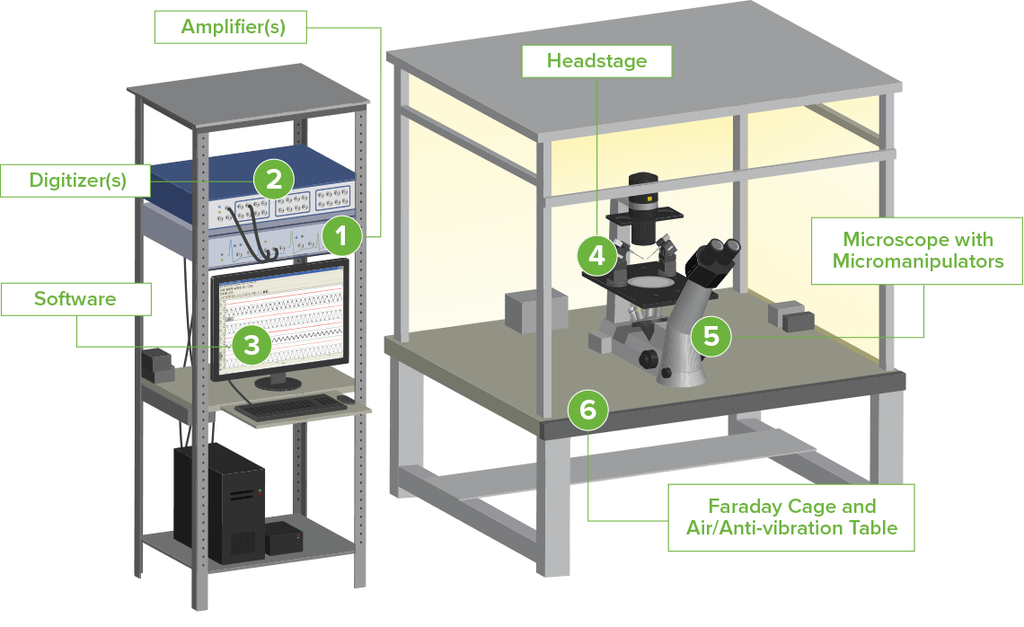

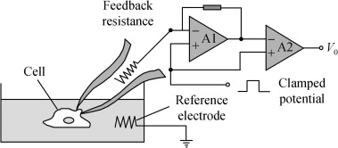
Patch clamp
Brain slices
Cell cultures
Recording from a single cell
Whole-cell patch clamp

Slide 12
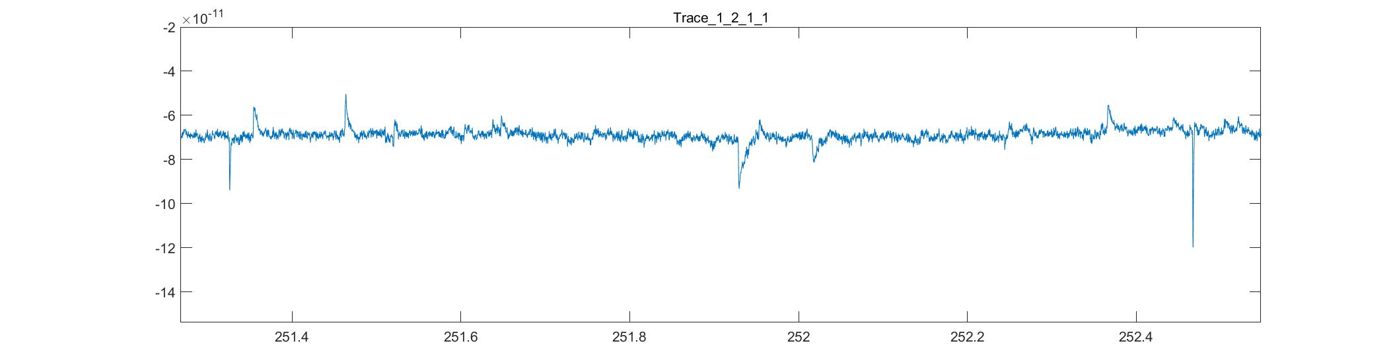
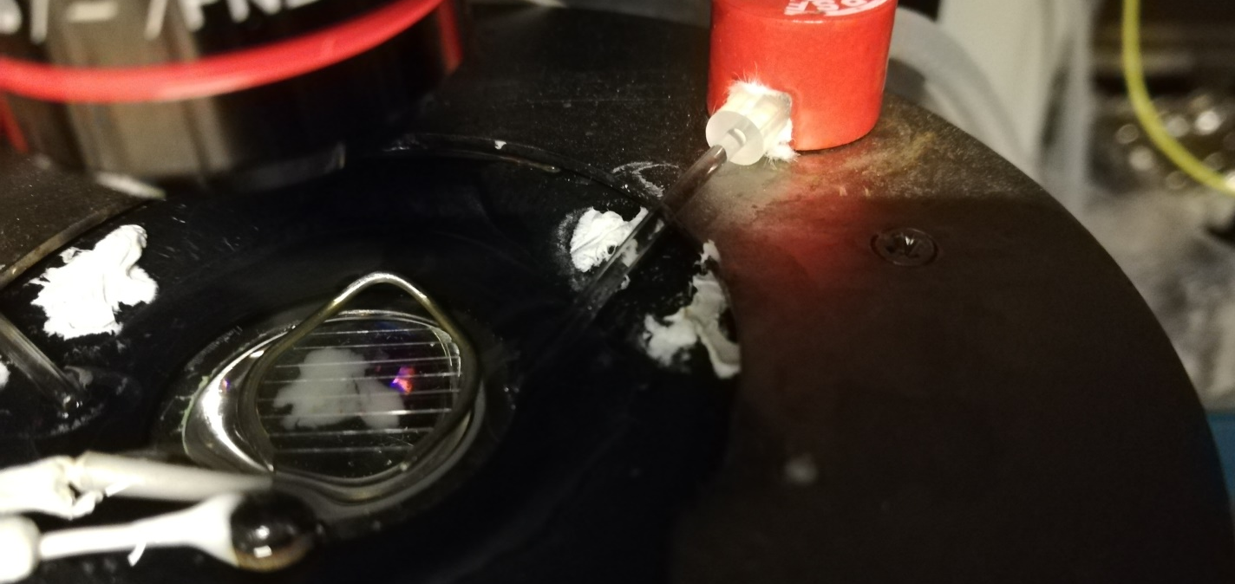
Spontaneous postsynaptic currents

Slide 13
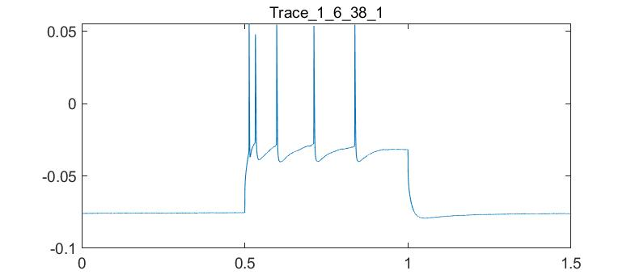
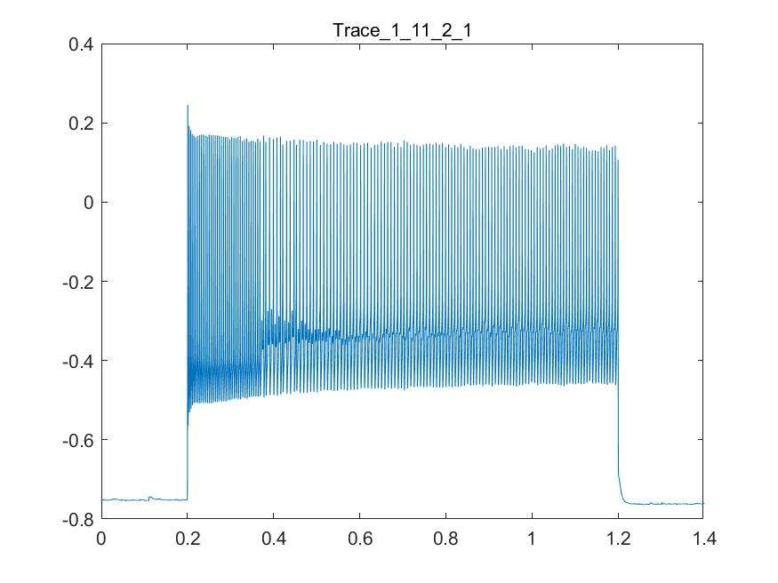
Depolarizing pulses, action potentials
Pyramidal neuron
Parvalbumine-positive inhibitory interneuron

Slide 14
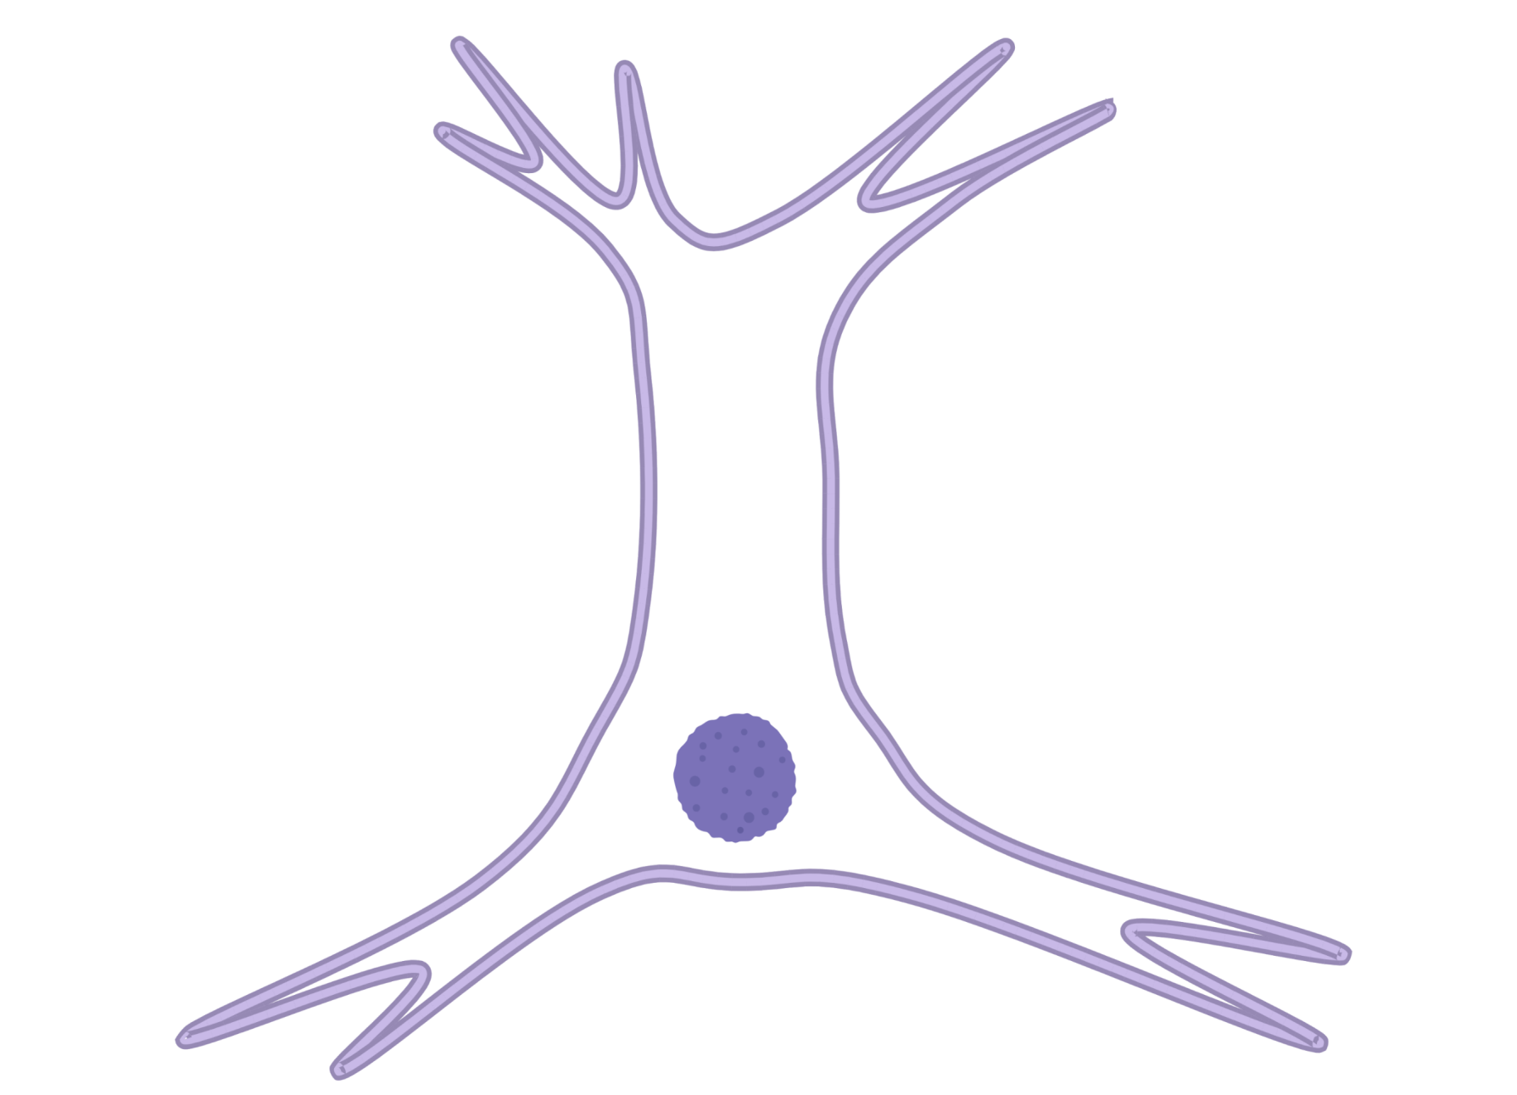
Origin of EEG signal

Slide 15
Origin of EEG signal

Slide 16
Origin of EEG signal
Scalp EEG
Extracellular recording
Intracellular recording
Extracellular recording

Slide 17
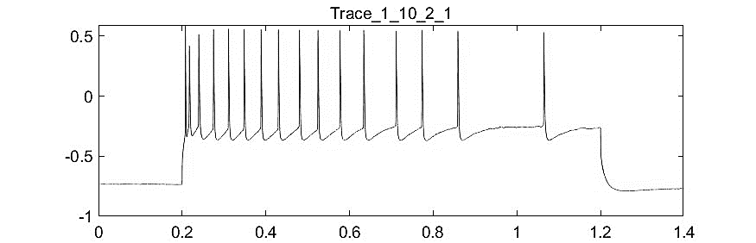
Origin of EEG signal
Scalp EEG
Extracellular recording
Intracellular recording
Extracellular recording

Slide 18
Origin of EEG signal
Scalp EEG
Extracellular recording
Intracellular recording
Extracellular recording

Slide 19
Origin of EEG signal
Scalp EEG
Extracellular recording
Intracellular recording
Extracellular recording

Slide 20
Origin of EEG signal
Scalp EEG
Extracellular recording
Intracellular recording
Extracellular recording

Slide 21
Origin of EEG signal
Scalp EEG
Extracellular recording
Intracellular recording
Extracellular recording

Slide 22
Origin of EEG signal
Scalp EEG
Extracellular recording
Intracellular recording
Extracellular recording

Slide 23
Origin of EEG signal
Scalp EEG
Extracellular recording
Intracellular recording
Extracellular recording

Slide 24
Origin of EEG signal
Scalp EEG
Extracellular recording
Intracellular recording
Extracellular recording

Slide 25
Origin of EEG signal
Scalp EEG
Extracellular recording
Intracellular recording
Extracellular recording

Slide 26
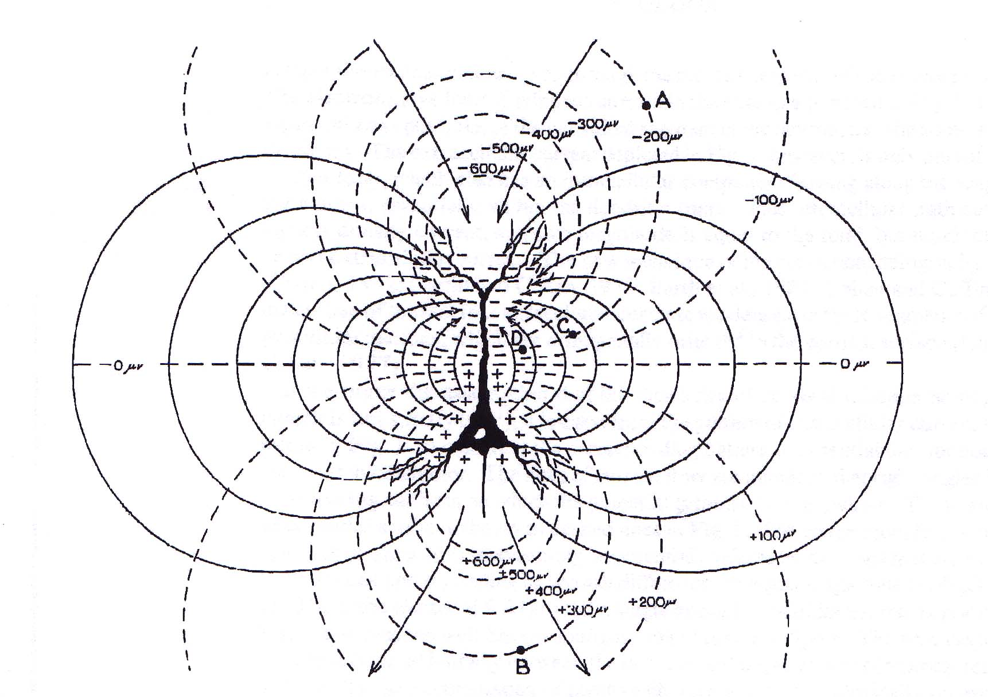
Lines of force and equipotential lines
voltage
current
-300 uV
-400 uV
-200 uV
-500 uV
-200 uV
-100 uV
-100 uV
0 uV
0 uV
100 uV
100 uV
500 uV
200 uV
400 uV
200 uV
300 uV

Slide 27
Morphology, amplitude a duration of EEG waves
Distance from the current generator
Duration of the postsynaptic potentials
Number of synchronous postsynaptic potentials
Position of the electrode with respect to the current generator
Anatomical orientation of the cells generating the currents

Slide 28
Morphology, amplitude a duration of EEG waves
Distance from the current generator
Duration of the postsynaptic potentials
Number of synchronous postsynaptic potentials
Position of the electrode with respect to the current generator
Anatomical orientation of the cells generating the currents

Slide 29
-100 uV
-300 uV
-400 uV
-200 uV
-200 uV
-500 uV
-100 uV
-100 uV
0 uV
0 uV
100 uV
100 uV
500 uV
200 uV
400 uV
200 uV
300 uV

Slide 30
-500 uV
-100 uV
-300 uV
-400 uV
-200 uV
-200 uV
-500 uV
-100 uV
-100 uV
0 uV
0 uV
100 uV
100 uV
500 uV
200 uV
400 uV
200 uV
300 uV

Slide 31
-500 uV
??? uV
-100 uV
-300 uV
-400 uV
-200 uV
-200 uV
-500 uV
-100 uV
-100 uV
0 uV
0 uV
100 uV
100 uV
500 uV
200 uV
400 uV
200 uV
300 uV

Slide 32
Morphology, amplitude a duration of EEG waves
Distance from the current generator
Duration of the postsynaptic potentials
Number of synchronous postsynaptic potentials
Position of the electrode with respect to the current generator
Anatomical orientation of the cells generating the currents

Slide 33
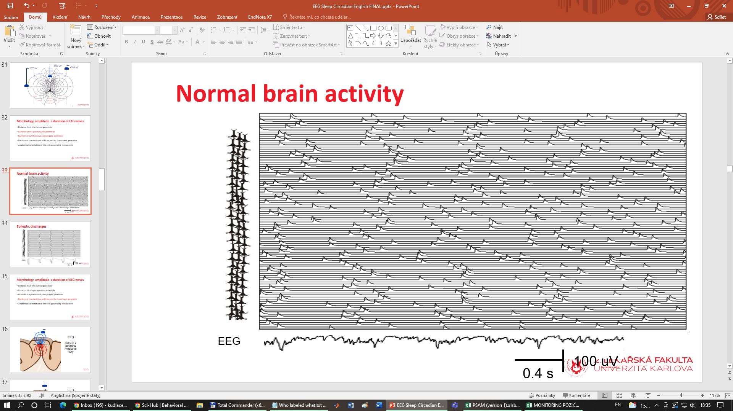
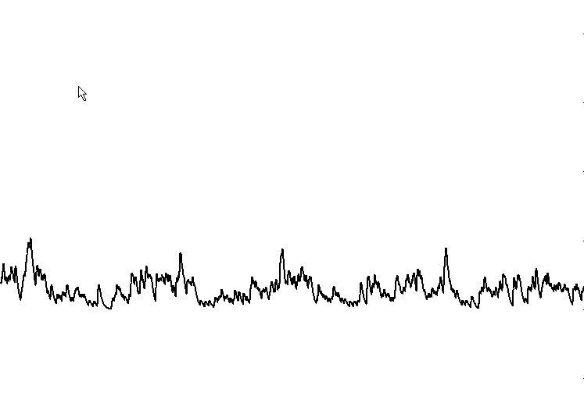
Normal brain activity
EEG
100 uV
0.4 s

Slide 34
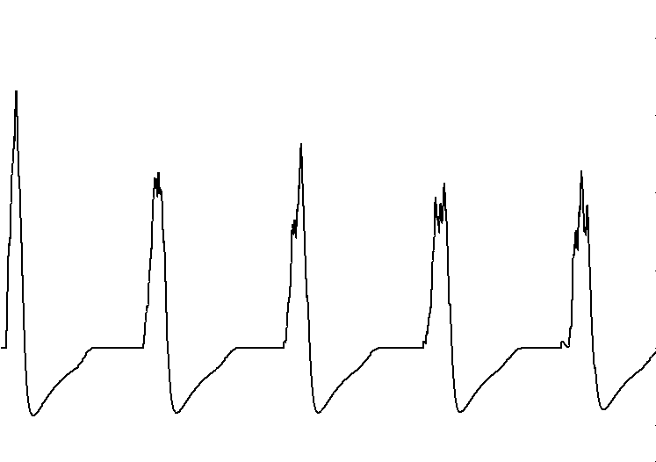
Epileptic discharges
EEG
100 uV
0.4 s

Slide 35
Morphology, amplitude a duration of EEG waves
Distance from the current generator
Duration of the postsynaptic potentials
Number of synchronous postsynaptic potentials
Position of the electrode with respect to the current generator
Anatomical orientation of the cells generating the currents

Slide 36
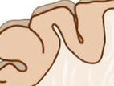
EEG
–
activity from the top of the gyrus

Slide 37
EEG
–
activity from the depth of the gyrus not seen in EEG
(could be seen in MEG)

Slide 38
Morphology, amplitude a duration of EEG waves
Distance from the current generator
Duration of the postsynaptic potentials
Number of synchronous postsynaptic potentials
Position of the electrode with respect to the current generator
Anatomical orientation of the cells generating the currents

Slide 39
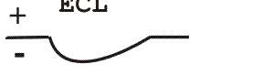
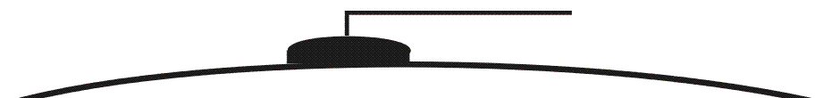
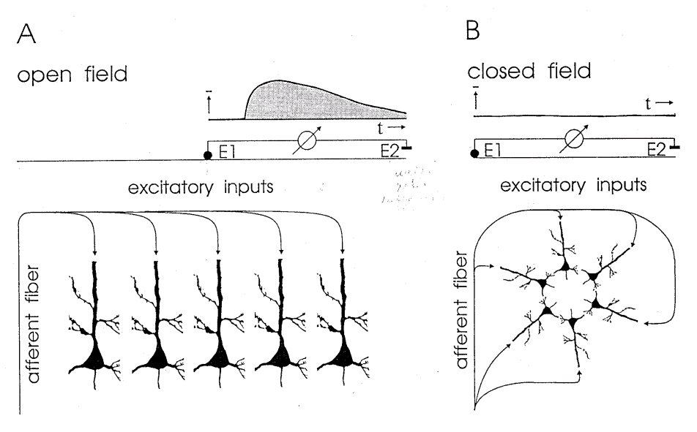
EEG
aferent fibers

Slide 40
EEG
aferent fibers

Slide 41
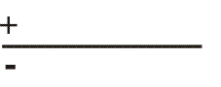
EEG
aferent fibers

Slide 42
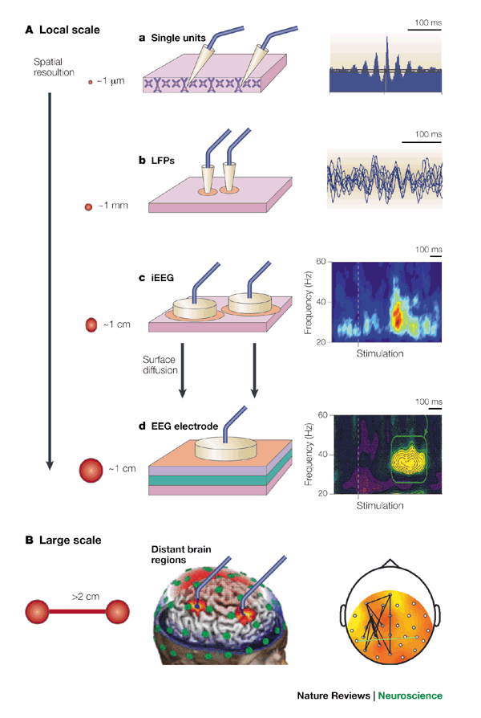
Electrodes
Scalp EEG
Intracranial EEG
> 1 cm
< 1 cm
Local field potentials (LFP)
Extracellularly recorded action potentials
~ 1 mm
~ 10 um
Notes:
Nase práce vychází z klinických pozorování

Slide 43
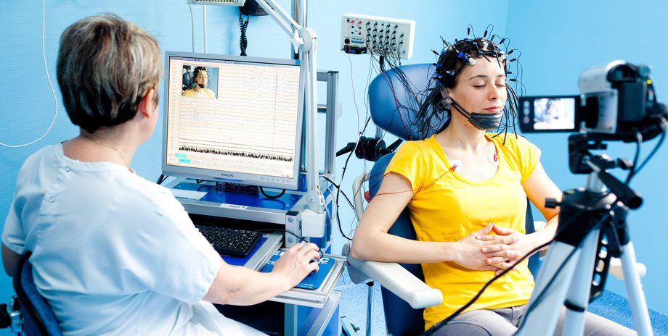
Scalp EEG
Notes:
Nase práce vychází z klinických pozorování

Slide 44
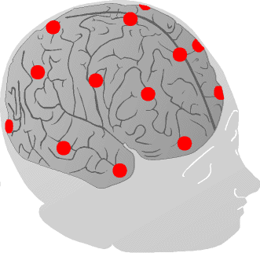
Scalp EEG – electrode positions
C4
International 10-20 system
Cz
Pz
F4
Fz
C3
P3
Fp2
F3
Fp1
T5
T3
F7

Slide 45
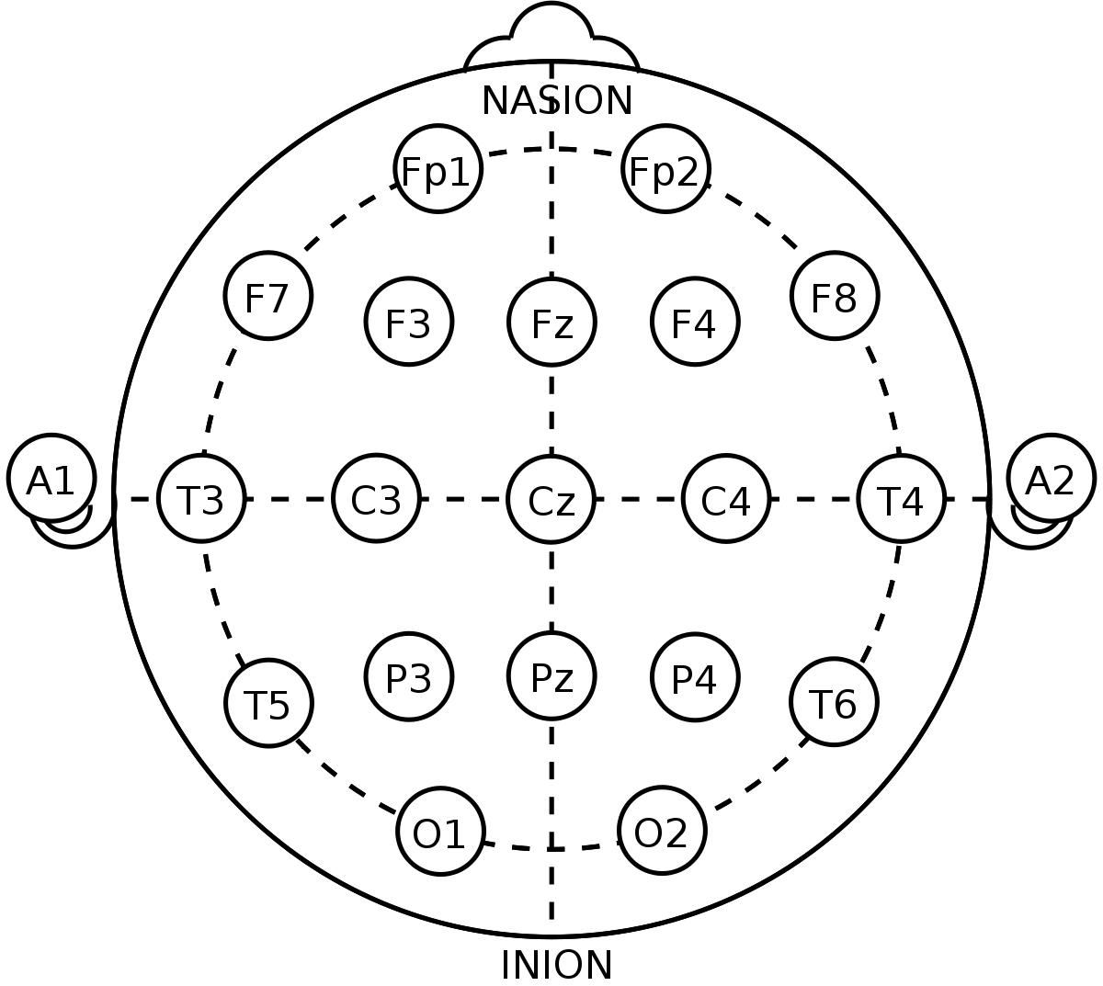
Scalp EEG – electrode positions
International 10-20 system

Slide 46
Montage
Positions of electrodes and type of referencing of the signals
Referential montage
  Scalp (active) electrode with respect to a reference (neutral) electorde
Bipolar (sequential) montage
  Scalp (active) electrode with respect to another scalp electorde

Slide 47
EEG – referential montage
1
Active electrode
EEG trace
+
1
0
0
0
0
Differential amplifier
0
0
0
0
Reference electrode
-
0
0
0
0
0

Slide 48
EEG – referential montage
Active electrode
EEG trace
0
0
0
0
+
0
0
0
0
-1
Differential amplifier
Reference electrode
-
0
0
0
0
0
-1

Slide 49
EEG – referential montage

Slide 50
EEG – bipolar montage
1
Active electrode 1
EEG trace
+
0.75
0
0
0
0
Differential amplifier
0
0
0
0
Active electrode 2
0.25
-
0
0
0
0

Slide 51
EEG – bipolar montage
1
Active electrode 1
EEG trace
+
0
0
0
0
1
Differential amplifier
0
0
0
0
0
Active electrode 2
-
0
0
0
0

Slide 52
EEG – bipolar montage
1 mV
2 mV
Active electrode 1
EEG trace
+
0
0
0
0
Differential amplifier
0
0
0
0
Active electrode 2
0
0
0
0
-
-1 mV

Slide 53
EEG – longitudinal bipolar montage

Slide 54
EEG – transversal bipolar montage

Slide 55
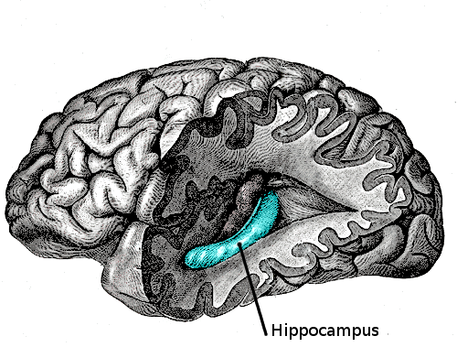
Deep structures
Deep structures
  Hippocampus
  Thalamus
  Brain stem
No contribution to scalp EEG
Indirect effect on the EEG

Slide 56
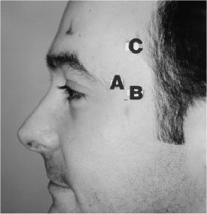
Supplementary anterior temporal electrodes
C4
Cz
Pz
F4
Fz
C3
P3
Fp2
F3
Fp1
T5
T3
F7

Slide 57
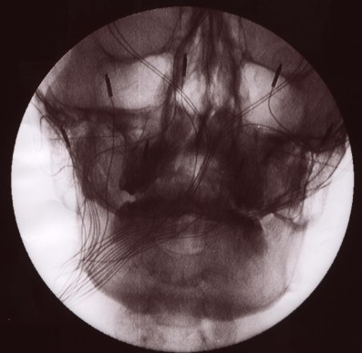
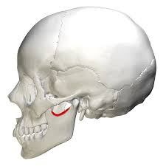
Sphenoidal electrodes

Slide 58
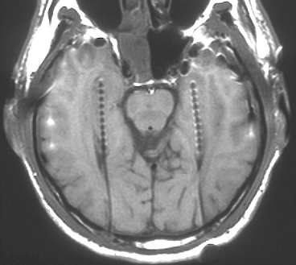
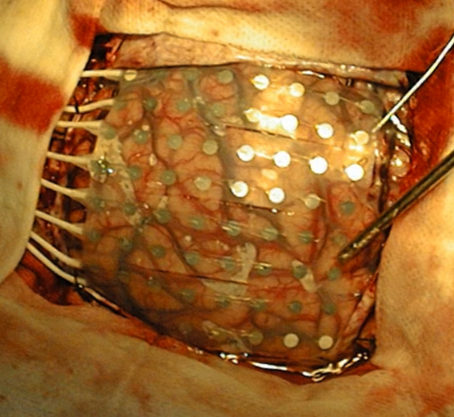
Intracranial (invasive) EEG

Slide 59
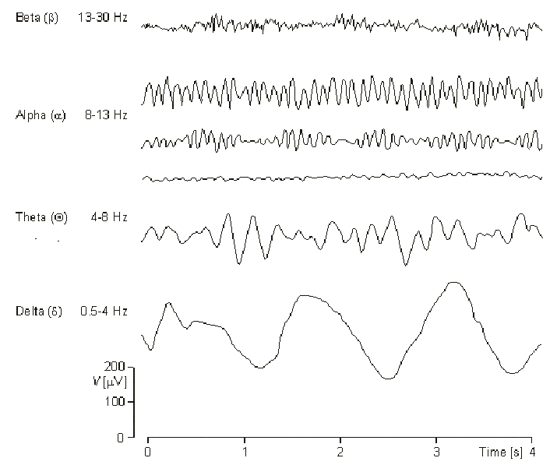
EEG frequency bands
β
13-30 Hz
α
8-13 Hz
ϑ
4-8 Hz
δ
0,5-4 Hz
100 uV
1 s

Slide 60
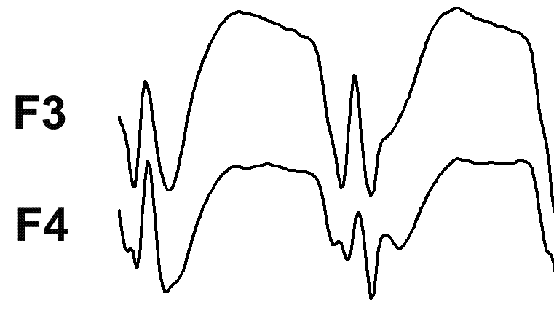
Spike-wave complex
100 uV
300 ms
Spike
Wave
Wave duration
Amplitude
Spike duration
Period/frequency
Event duration
Notes:
Nase práce vychází z klinických pozorování

Slide 61
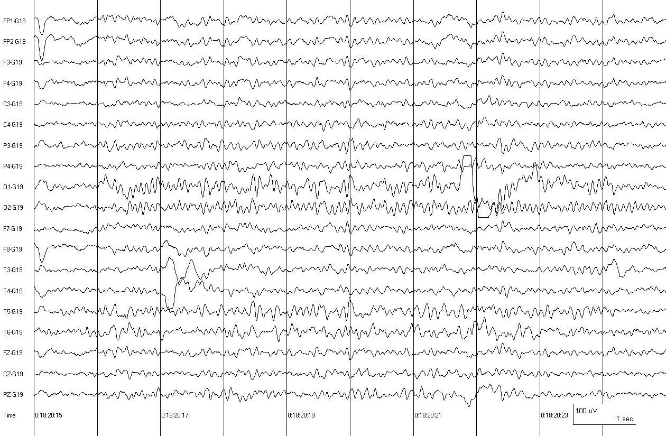
Waking EEG

Slide 62
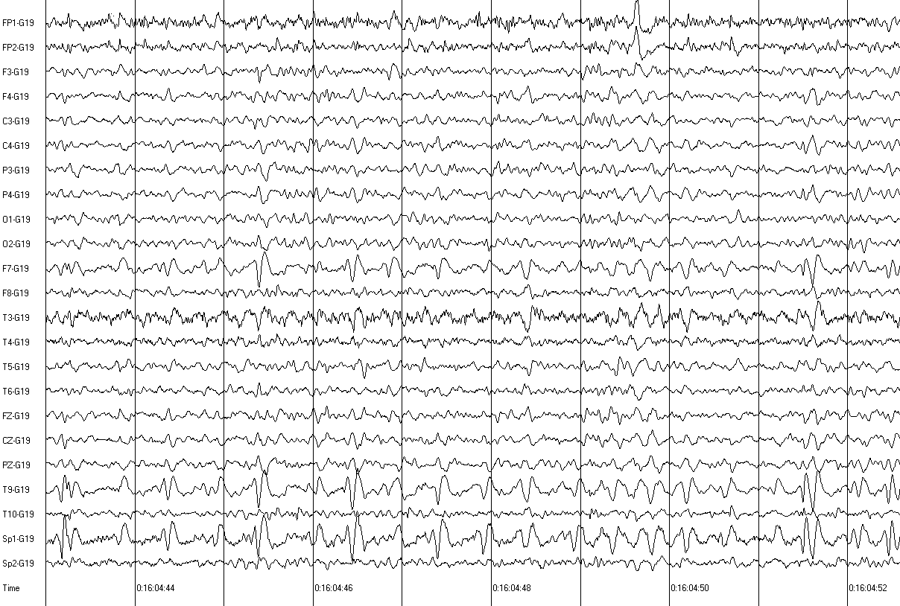
Temporal lobe epilepsy

Slide 63
Temporal lobe epilepsy

Slide 64
Supplementary anterior temporal electrodes
C4
Cz
Pz
F4
Fz
C3
P3
Fp2
F3
Fp1
T5
T3
F7

Slide 65
Temporal lobe epilepsy with the supplementary anterior temporal electrodes

Slide 66
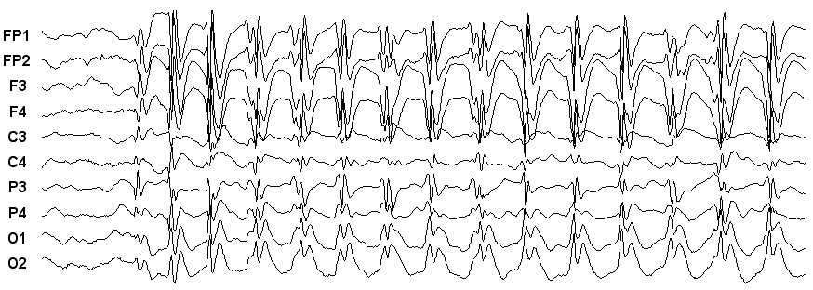
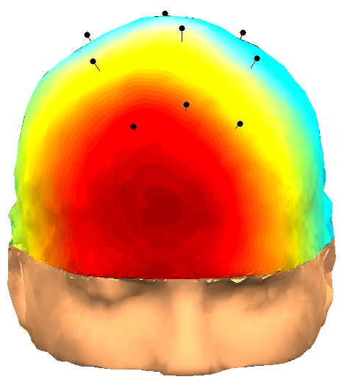
Absence seizure
Notes:
Nase práce vychází z klinických pozorování

Slide 67
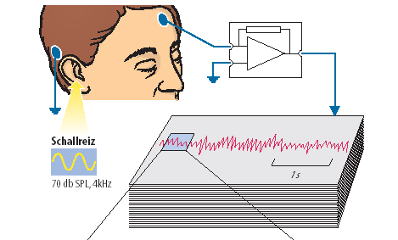
Evoked potentials – recording

Slide 68
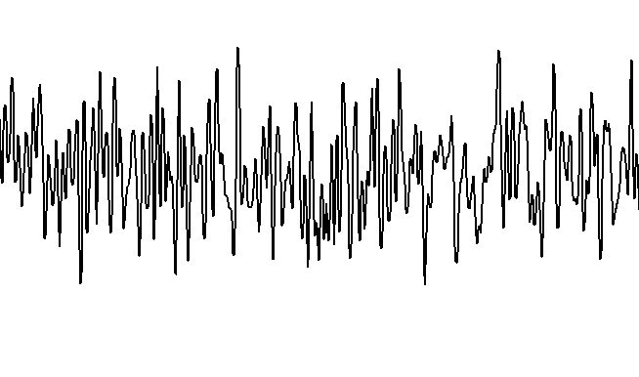
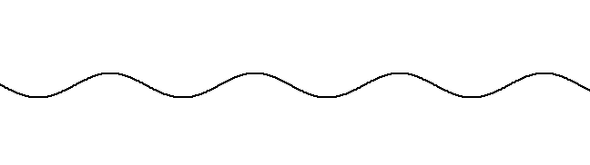
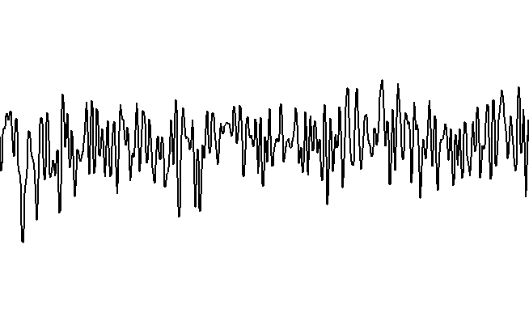
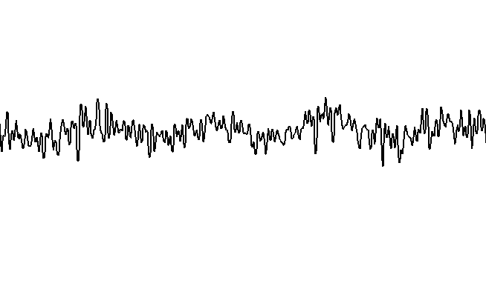
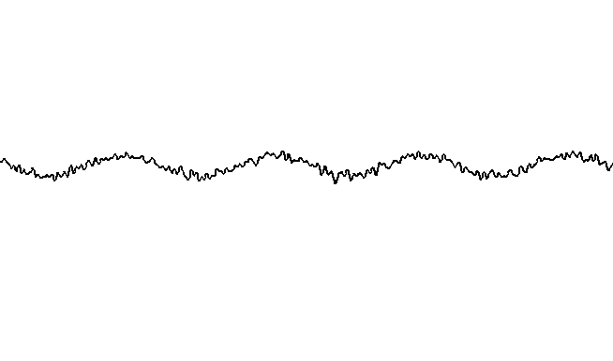
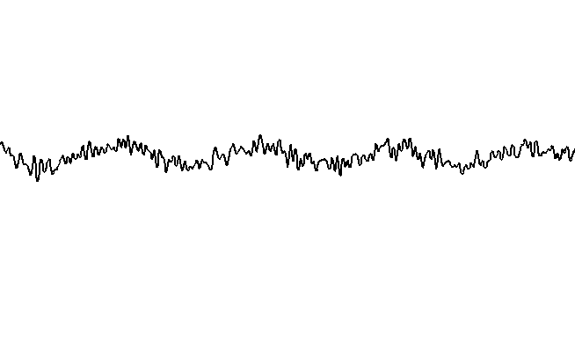


Evoked potentials – averaging
Evoked response
Background activity
+
10x averaging
500x averaging
100x averaging
1000x averaging
200x averaging
3000x averaging

Slide 69

Brainstem Auditory Evoked Potentials
I - auditory nerve
II - cochlear
III - superior olivary nuclei
IV - lateral lemniscus
V - inferior colliculi
II+III - pons
IV+V - midbrain
Left ear stimulation at 60 dB.

Slide 70

Visual evoked potentials
Pattern reversal evoked potentials
Or just blinking (infants, comatose patients)
Diagnosis of multiple sclerosis, demyelination related diseases, etc.

Slide 71


Visual evoked potentials
Healthy eye
Diseased eye

Slide 72
Sleep

Slide 73

What is the sleep?
Basic physiological need
Behavioral state
  Reversible
  Low interaction with environment
  Decrease motor activity
  Stereotype postures

Slide 74

Polysomnography
Monitoring of various physiological signals during sleep

Slide 75
Sleep stages
Non-REM
  Classification NREM 1-3
  Alternatively Stage 1-4
  Low neuronal activity
  The lowest level of the brain metabolism
  Decrease of sympathetic activity
  Muscle tone and reflexes intact
REM (Rapid eye movements)
  Rapid eye movements
  Muscle atonia
    Not in REM behavioral disorder (RBD)
  Increased neuronal activity
  Increased metabolism
  EEG similar to waking
  “Paradoxical sleep”
  Vivid dreams

Slide 76

Sleep EEG
B
A
T
S
Drink
Blood
12-30 Hz
8-12 Hz
4-7 Hz
1-4 Hz
1-4 Hz
12-30 Hz

Slide 77


Hypnogram, sleep cycles
Cycle duration 90 – 110 minutes
4 – 6 cycles per night

Slide 78

Physiological changes during sleep

Slide 79

Physiological changes during sleep
Heart rate
Respiration
Penile erection

Slide 80

Sleep during development and aging

Slide 81

Wakefulness and sleep-wake transitions
Ascending reticular activating system (ARAS)
  All components innervated by orexin neurons
  Connections to cortex, etc.
Orexin/hypocretin
  Neuropeptide
  Maintains wakefulness
  Only 10 000 to 20 000 orexin neurons in human brain
  Lack of orexin neurons -> narcolepsy

Slide 82

Narcolepsy
Sleep disorder
Excessive daytime sleepiness
Sleep attacks with sudden atonia
Initiation with REM sleep
Cataplexy
  Sudden atonia while conscious
  Descendent inhibitory system
Lessened quality of sleep

Slide 83



Narcolepsy
normal hypothalamus
Mechanism
  Loss of orexin neurons
Causes
  Genetic predisposition
  Environmental factors
    Autoimmune disorder triggered by H1N1 infection
Treatment
  Amphetamines
  Tricyclic antidepressants
  Orexin
narcolepsy

Slide 84
Role of sleep
Not entirely elucidated
Important for cognition
  Memory consolidation
Toxin clearing
Immune system more active during sleep
Sleep deprivation
  Followed by sleep compensation
  If severe, can lead to death

Slide 85
Circadian rhythms

Slide 86
Circadian rhythm
Changes in behavior due to alternating day and night
Predicting the day and night advantageous
Circadian clock developed in all organisms

Slide 87

Molecular mechanism
Molecular oscillator in each cell on earth
Principle: The protein product inhibits its own transcription by feedback mechanism
In the human body, the cells need to be synchronized
  Suprachiasmatic nucleus (SCN)

Slide 88




Synchronization by SCN
Ganglion cells in the retina (not rods or cones)
Send information about daylight to the suprachiasmatic nucleus (SCN)

Slide 89

Damage to SCN
Normal
SCN lesion

Slide 90

Free-running period
In constant darkness (or constant light)
The SCN oscillates at approx. 24 hour period
In most humans, around 25 hours

Slide 91
Chronotherapy
Administration of drugs (or other treatment) at the time when it is most effective/has least adverse effects
  Heart attacks most probable in the morning due to highest blood pressure -> the best time for taking the drugs for blood pressure
  Antiseizure medication administered at the time when most seizure occur
  etc.

Slide 92
Thank you for your attention
Questions?
Comments?
Suggestions?
kudlaceksystem@gmail.com

